Slide 1
Research Roadmap
for
Service Oriented Computing
Mike P. Papazoglou
Executive Director ERISS:
European Research Institute in Service Science
Tilburg University,The Netherlands
email: mikep@uvt.nl
http://www.eriss.org
Notes:
1

Slide 2
AGENDA
Overview, Vision & Aim
Example: Smart Services
Services & SOA
Services in the Cloud
Research Roadmap
Final Remarks

Slide 3
TALK OBJECTIVES
Overall Objective:
  Understand the forces behind Service Oriented Computing
  Understand the nexus between SOA, BPM & the Cloud
  Present a Service Oriented Computing Research Roadmap
  Place on-going research activities and projects in the broader context of this roadmap.
Basic understanding of Web services, standards & SOA is assumed.
Michael P. Papazoglou © "Research Roadmap in Service Oriented Computing" Summer School, Espoo, Finland - August 26, 2011

Slide 4
Overview, Vision & Aim

Slide 5

The Services Tsunami
Michael P. Papazoglou © "Research Roadmap in Service Oriented Computing" Summer School, Espoo, Finland - August 26, 2011

Slide 6
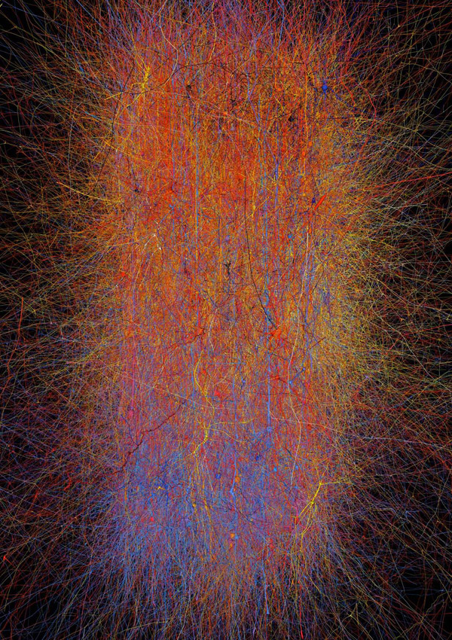
The Cloud Computing Revolution
Michael P. Papazoglou © "Research Roadmap in Service Oriented Computing" Summer School, Espoo, Finland - August 26, 2011

Slide 7
Examples

Slide 8



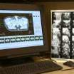




Vision: The Twain Shall Meet
The world needs to get smarter – more instrumented, interconnected & lead to better decision making.
Smarter Service & Cloud technologies are central to this vision.
Global-reach agile service-based apps are effectively deployed into a variety of devices & different implementation platforms - in particular federated cloud computing formations.
Smart traffic systems
Smart business systems
Smart food systems
Smart healthcare
(Process-intensive & event-driven apps)
Smart water management
Smart supply chains
Smart telephony
Smart cities
Michael P. Papazoglou © "Research Roadmap in Service Oriented Computing" Summer School, Espoo, Finland - August 26, 2011
Notes:
Our healthcare is becoming smarter as well, and generating vast amounts of information. For example, today not only do they provide one dimensional x-rays, and MRI images, today we do both in 4 dimensional imaging – that is full 3-D with the factor of time added in. These ‘streaming” images are providing huge insights in improving overall healthcare, but they are also presenting huge challenges in medical record management, storage, and accessibility (i.e.., networking bandwidth).
Smarter retail and smarter supply chains mean leveraging RFIDs and digital information to make the shopping experience better for the consumer, and making sure that what the customer wants to buy, is on the shelf. Another example is leveraging security cameras to monitor shopper behavior, or the ability to then move stock that is in high demand to more convenient places for customers to see and buy. Or, targeting certain buyer categories based on their shopping habits. Much is being done to improve store sales, while simultaneously improving the shoppers experience and thereby customer loyalty.

Slide 9
Services & SOA

Slide 10
What are Software Services?
Software services are self-contained, platform-agnostic computational elements that support rapid, low-cost and easy composition of loosely coupled distributed software apps.
Services are described, published, discovered & can be assembled to create complex service-based systems and applications.
  They help integrate applications not written with the intent to be easily integrated with other applications &
  define architectures to build new functionality while integrating existing application functionality.
Service-based apps are developed as independent sets of interacting services offering well-defined interfaces to their potential users using the principle of loose coupling.
Michael P. Papazoglou © "Research Roadmap in Service Oriented Computing" Summer School, Espoo, Finland - August 26, 2011

Slide 11
What is an SOA?
Logical approach to designing a software system to provide services to either end-user applications or to other services distributed in a network - via published and discoverable interfaces:
  Designs services in a way that they can be invoked by various service clients & are logically decoupled from any service caller.
  Creates service level abstractions that map to the way a business actually works.
  Helps create composite applications which automate business functions.
  Leverages investment in existing application assets.
  Makes use of reference models & best practises.
Michael P. Papazoglou © "Research Roadmap in Service Oriented Computing" Summer School, Espoo, Finland - August 26, 2011

Slide 12
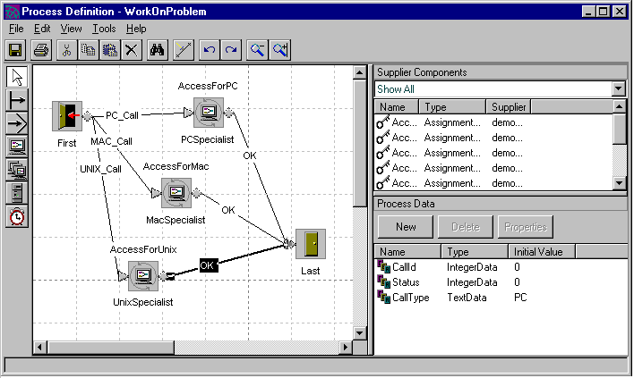
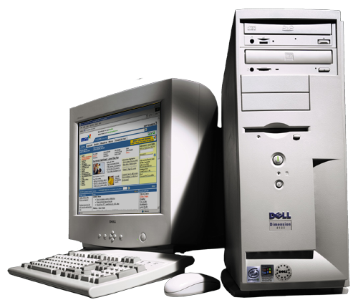


SOA Reference Model
Distribution
Business (service) Domain
Purchasing
Order Management
Inventory
Logical
View
IMPORTANT QUESTIONS TO ASK:
At which level of granularity do I identify business services?
Which operations does a business service support?
How do I compose/decompose business processes?
How do I achieve loose-coupling, reusability & service cohesion?
Which infrastructural services do I need to realize business services?
Do I buy/lease/outsource new services? Or can I reuse my legacy resources?
How can I govern & manage the service development process?
….
Business Processes
Process
decomposition/
composition
create, modify, suspend,
cancel orders,
schedule orders,
create, modify, delete
bulk orders,
order progress
Business Services
Infrastructure Services
Physical
View
Component-based service realizations
CRM
ERP
Packaged
Applications
Legacy
Applications
Operational Systems - reuse
Databases
Michael P. Papazoglou © "Research Roadmap in Service Oriented Computing" Summer School, Espoo, Finland - August 26, 2011
Notes:
This slide captures a blueprint for SOA applications. Basically, SOA envisions support of cross-enterprise processes.
A service domain is a functional domain comprising a set of current and future business processes that share common capabilities and functionality and can collaborate with each other to accomplish a higher-level business objective, e.g., loans, insurance, banking, finance, manufacturing, human resources, etc. In this way a business can be portioned into a set of disjoint domains. Examples of service domains include distribution, finance, manufacturing, and human resources.
The order management business process performs order volume analysis, margin analysis, sales forecasting and demand forecasting across any region, product or period. It can also provide summary and transaction detail data on order fulfilment and shipment according to item, sales representative, customer, warehouse, order type, payment term, and period. Furthermore, it can track order quantities, payments, margins on past and upcoming shipments, and cancellations for each order. The purchasing process provides purchase order details (quantity, unit price and extended price) according to purchase order, vendor, buyer, authorizer, inventory item, any chart of accounts combination, and non-invoiced receipts. Finally, the inventory process helps track the amount of inventory on hand, expected arrival of items, and monitors the movement of physical inventory.
Business services are supported by infrastructure, management and monitoring services. These services provide the infrastructure enabling the integration of services through the introduction of a reliable set of capabilities, such as intelligent routing, protocol mediation, and other transformation mechanisms, often considered as part of the Enterprise Service Bus.
All service domains, business processes and services are automatically populated with financial and operational functions and data available from resources such as ERP, databases, CRM and other systems, which lie at the bottom of the service lifecycle development hierarchy. However, component implementation is an issue that can seriously impact the quality of available services. Both services and their implementation components need to be designed with the appropriate level of granularity

Slide 13
Business Processes as Services
Focus concentrates on Business Processes
The Business Process as Service
The Business Process as a Catalyst for Collaboration
Request
Collaboration
(service contract &
business protocol)
Service Interface
Process K
Process Implementation
Process L
Process
Performer Roles
Person
Application
Request-response
Process M
Process N
Michael P. Papazoglou © "Research Roadmap in Service Oriented Computing" Summer School, Espoo, Finland - August 26, 2011

Slide 14
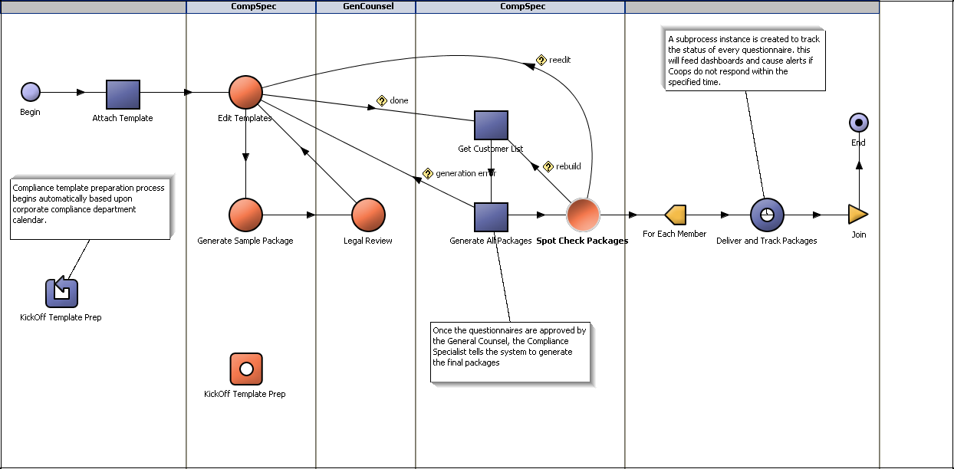
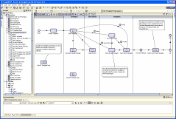
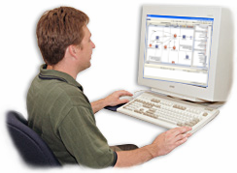
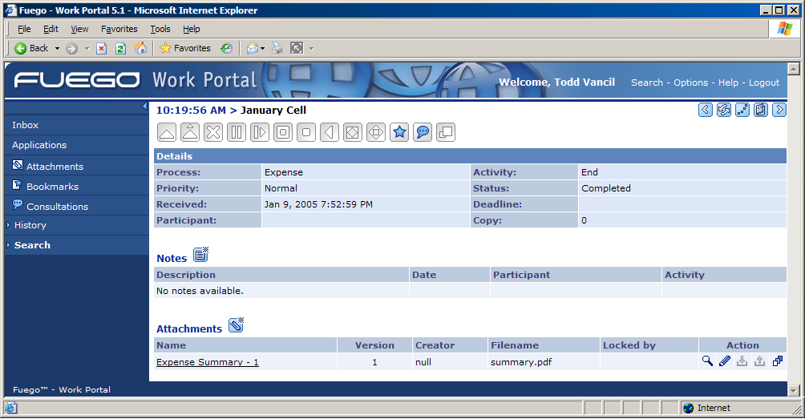
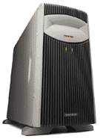





A Quick Look at Business Process Management
Business
Analysts
Process Modeling, Simulation
and Documentation
Process
Analyst
Process Development
and Systems Integration
Business Use Cases
Business-domain overview
Business process interaction patterns
Requirements
Process Model
Interactive, real time dashboards
Proactive alerts & monitoring screen
Process
Participants
BPM-middleware
Business
Management
Process Workspace
CRM
SCM
Process Management & Business Activity Monitoring
Historical & Trend Analysis Tools
ERP
Enterprise
Information
Systems
Process and
Monitoring Repository
Michael P. Papazoglou © "Research Roadmap in Service Oriented Computing" Summer School, Espoo, Finland - August 26, 2011
Notes:
As with every IT project, the Systems Analysts interview the Business Owners to understand the use cases, requirements, etc. Uniquely a business process model is used to gain understanding and agreement not just between the Business Owners and Systems Analysts, but even between individuals in the Business Owners group (we would all be surprised how often there is real disagreement about how our processes actually work).
**CLICK**
That process model (along with the documentation you embed directly within it) becomes the contract between the Business and IT. Once the Systems Analysts complete the model and future Test Cases, **CLICK** they share the model with the Development Team who will complete the detailed work of connecting the model to the systems and human interfaces required to complete the Process Application. As the diagram indicates, **CLICK** this is very often an iterative process that serves to further solidify that contract between the Business and IT.
Once the Developers are finished, **CLICK** the completed Process Application is deployed in the BPM system for execution. The BPM system manages the interaction **CLICK** of humans and systems in the process and stores every event in its state repository. Since this repository contains process AND business data, it provides management **CLICK** interfaces and dashboards to the Business Owners. These are real-time displays showing status at any level of the process. For example, one executive may be viewing a Balanced Scorecard while a business operations expert may have a dashboard depicting adherence to Service Level Agreements.
This data provides the final link in the lifecycle chain that allows the business to further refine and improve the process. As you can see, this is an iterative lifecycle that fosters and enables Continuous Process Improvement.

Slide 15
Services in the Cloud

Slide 16
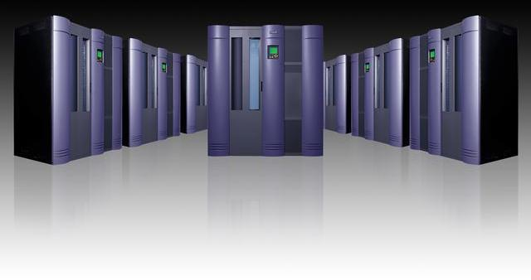

SOA in the Cloud
End-to-end Processes
Service
Provider
Service-based Application
Service interface
Purchasing
Service
Provider
Service-based Application
Service interface
Order Management
Service
Provider
Service-based Application
Service interface
Inventory
Billing & Collections Management
Service
Provider
Service-based Application
Service interface
Cloud environment
(platform & infrastructure providers)
Michael P. Papazoglou © "Research Roadmap in Service Oriented Computing" Summer School, Espoo, Finland - August 26, 2011
16
Notes:
Figure 1 shows that, for instance, in the telecommunications industry an end-to-end process constellation could compose of globally available end-to-end processes managing customer orders, billing, payment collection, purchases, new sales and service fulfilment.

Slide 17

Cloud: Consumption & Delivery Models Optimized by Workload
Cloud Overview
“Cloud” is:
Cloud enables:
A new consumption and delivery model inspired by consumer Internet services.
  Infrastructure configuring
  Highly virtualized infrastructure
  Sourcing options
  Economies-of-scale
Cloud Services
Cloud Computing Model
“Cloud” represents:
Multiple Types of Clouds
will co-exist:
  The Industrialization of Delivery for IT supported Services
  Private, Public and Hybrid
  Workload and/or Programming Model Specific
Michael P. Papazoglou © "Research Roadmap in Service Oriented Computing" Summer School, Espoo, Finland - August 26, 2011
17
Notes:
17
Cloud computing is one answer to this crisis of complexity in the data center (caused by a Smarter Planet).
The consumer Internet is arguably the biggest infrastructure in operation today and so it is not surprising, that consumer Internet services or consumer clouds, are informing the next generation of enterprise IT delivery.
We think of clouds primarily as a new way of consuming and delivering IT-enabled services.
Many of us use them every day – when we upload our pictures on the Internet for sharing or we download maps for our GPS devices etc. We are not even aware of infrastructure or location.
As we translate this approach to the enterprise, we think three aspects of the cloud model are particularly compelling:
Self-service – a new relationship with IT, which enables the user a degree of freedom in configuring and accessing services and can dramatically reduce labor on the delivery side.
Flexible sourcing options - the idea of more choices and, a hybrid modes of delivery that allows CIOs to optimize costs and qualities of service by work load
And much greater focus on scale – that enables both new economics and new capabilities.
Most people think about “self-service” from the user and user interface perspective. But more interesting to the delivery team is the process standardization behind it…the way we enable the user interaction with a process that used to be served up by a person. This person was someone with control of the process – access, quality of service and client satisfaction.
But we know from a delivery perspective that this model changes a lot more then the interface. It drives the need for a new level of discipline, codification of processes and standardization of the back-office.
Think of the ATM in banking….it started as cash dispensing function. This drove a level of internal standardization, but as networks got connected, it forced standards for networking and security across the industry when you want to access money from one back through the ATM of another. In fact, it became a platform for a whole host of retail transactions.
We know that IT represents a broad, complex set of functions and is vastly more complex and siloed. As a result, this evolution is equally complex. But the opportunity is to drive operational efficiency and improve service quality and satisfaction..
The second key area is sourcing. The cloud model provides a set of new options.
We have been there before – if Intranets and Extranets were about exploiting Internet technology for content, clouds are about computing infrastructure and services.
There are criteria that inform where you compute and how you use the delivery options – Security, control, level of flexibility etc.
One aspect that is often underestimated is the advantage in ‘time-to-market’ – a ‘ready-to-use’ service that can be plugged into an existing infrastructure, seamlessly for the user can be a great option for timing and lower risk.
There are many considerations, but none is more important then the role of the IT organization and managing IT services on both sides of this boundary. We know from experience the cost of letting new technologies and paradigms run wild in the enterprise.
The management system and governance of this hybrid infrastructure will be critical to successfully integrating a cloud in the enterprise.

Slide 18


Cloud Computing & Delivery Models
Cloud
Applications
(Built by
customer)
Software as a Service (SaaS)
Applications (ERP, SCM, CRM)
Processes
Information
Platform as a Service (PaaS)
Middleware – application servers,
Process automation middleware,
Database servers,
Enterprise portal servers, etc.
Cloud
Service
Models
(Provided by Cloud Providers)
Infrastructure as a Service (IaaS)
Virtualized servers,
Storage,
Networking
Public
Private
Hybrid
Cloud Deployment Models
Michael P. Papazoglou © "Research Roadmap in Service Oriented Computing" Summer School, Espoo, Finland - August 26, 2011
18

Slide 19
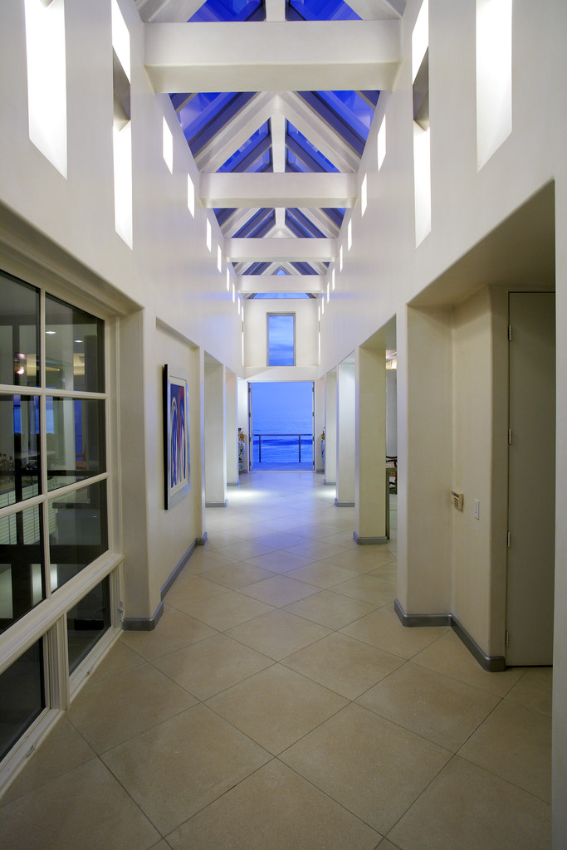
Cloud Architecture
Service
Consumer
Service
Developer
Service Provider
Cloud
apps
Security
Cloud
apps
Service
Management
Cloud
apps
User
Interface
Data
Privacy
Capacity
Mgmt
Service
Template
Creation
Software as a Service (SaaS)
Data Network
Security
SLA
Mgmt
Platform as a Service (PaaS)
Service
Template
Publication
SLAs/
contracts
Service
Billing
Standard APIs
Certification & compliance
Infrastructure as a Service (IaaS)
Standard APIs
Service
Reporting
Virtualized Resources
Virtual Image Mgt
Service
Analytics
&
Reporting
Authentication
& Authorization
servers
storage
Image Library
Service
Metering
network
Image
Auditing
&
Accounting
Service
Provisioning
Software Kernel (OS, Virtual Machine Manager)
Service
Monitoring
Hardware
Michael P. Papazoglou © "Research Roadmap in Service Oriented Computing" Summer School, Espoo, Finland - August 26, 2011
19

Slide 20
Research Roadmap

Slide 21
Some Long-term Research Challenges
Service networks are globally dispersed, are possibly created dynamically & are characterized by:
  Openness
  Scalability
  Evolvability/adaptability
  Demand rather than supply driven processes: business process activity driven by actual customer demand
  Support for a change-oriented lifecycle
  Innovation, i.e., support for innovative business models
  User empowerment
Michael P. Papazoglou © "Research Roadmap in Service Oriented Computing" Summer School, Espoo, Finland - August 26, 2011

Slide 22
Extended SOA (xSOA)
Modelling,
Design & Development
Methodologies
Management & Monitoring
Service operator
BPM
Market maker
Certification
Rating
SLAs
Management services
Semantics
Non-functional characteristics
QoS
Operations
Auditing
Support
Composition
Composite services
Service provider
Coordination
Conformance
Transactions
SOA
Basic services
Foundation
(Architecture, Description & basic operations)
Capability
Interface
Behaviour
Publication
Discovery
Selection
Binding
Role actions
Service client
performs
publishes
uses
Service aggregator
becomes
Michael P. Papazoglou © "Research Roadmap in Service Oriented Computing" Summer School, Espoo, Finland - August 26, 2011

Slide 23
Summary of Research Themes
Service Foundations: runtime infrastructure, architectures, e.g., Enterprise Service Bus, modes of service delivery = mobile, palm tops, hand held devices, networks, e.g., cable, UMTS, XDSL, Bluetooth, etc.
Service Composition/Assemblies: service composition, QoS composition, SLA composition, etc.
Service Management: support for discovering, introspecting, securing, and invoking resources, management functions, measurement, performance indicators, management infrastructure services and toolsets.
Service Development Life Cycle (Service Engineering): service analysis, design methodologies, implementation techniques, construction and testing, provisioning, deployment, execution and monitoring, business process modelling tools.
Cross-cutting concerns: QoS, semantics, non-functional characteristics, security, …
Michael P. Papazoglou © "Research Roadmap in Service Oriented Computing" Summer School, Espoo, Finland - August 26, 2011

Slide 24
SERVICE FOUNDATIONS:
State of the Art
The Enterprise Service
Bus (ESB) provides an
integration infrastructure
for SOA . It:
loosely couples the systems taking part in the integration
breaks up the integration logic into distinct easily manageable pieces
provides translation, integration, security & BP execution facilities.
Service orchestration –based custom applications
Portals
Reliable Asynchronous Secure Messaging
service interface
service
container
Distributed query engine
Web Services
JMS/
J2EE
MQ gateway
Adapters
WebSphere, .NET apps
Java apps
Mainframe & legacy
apps
Data sources
Enterprise applications
Multi-platform support
Michael P. Papazoglou © "Research Roadmap in Service Oriented Computing" Summer School, Espoo, Finland - August 26, 2011

Slide 25
SERVICE FOUNDATIONS:
Some Typical Research Challenges
Requirements for the service implementation infrastructure:
  is the cloud model appropriate for SOC?
  provisioning mechanisms, e.g., end-to-end security, transactions, etc.
  composition of policies
  end-to-end QoS
Dynamically (re-)configurable run-time architectures:
  The run-time service infrastructure should be able to configure itself and be optimized automatically in accordance with specific application requirements & high-level policies (representing business-level objectives)
  Plug-in Architecture to deal with extensible set of QoS properties:
    How do we deal with: end-to-end security solutions, multiple SLAs, business-aware transactions, flexible pricing schemes, etc.
Demand-driven creation & evolution of agile service networks.
Michael P. Papazoglou © "Research Roadmap in Service Oriented Computing" Summer School, Espoo, Finland - August 26, 2011

Slide 26
Breaking the Cloud Monolith
Client-1
Client-2
Client-3
Client-n
Virtualized applications
comprising end-to-end
Processes
(BPaaS-Layer)
Cloud Service
Applications
Client-1
Client-2
Application
Client-n
SaaS-1
SaaS-2
SaaS-3
SaaS-n
Software as a Service (SaaS)
Applications (ERP, SCM, CRM)
Processes
Information
Platform as a Service (PaaS)
Middleware – application servers
Process automation middleware
Database servers
Enterprise portal servers, etc.
PaaS-1
PaaS-2
PaaS-3
PaaS-n
Infrastructure as a Service (IaaS)
Virtualized servers
Storage
Networking
IaaS-1
IaaS-2
IaaS-3
(a) Monolithic delivery stack
(b) Syndicated multi-channel cloud delivery model
Michael P. Papazoglou © "Research Roadmap in Service Oriented Computing" Summer School, Espoo, Finland - August 26, 2011

Slide 27
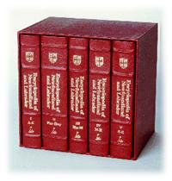

The Blueprint Model for Cloud Services
Source
Blueprint model
Blueprint Definition
Language
Customized
source
blueprints
Blueprint Query Engine
AD
SP
User
Marketplace Repository
Selection
SP
Blueprint Definition
Language
Source
Blueprint
models
SP
Blueprint Definition
Language
Customized
source
blueprints
Blueprint Manipulation
Language
AD
+
Design
User
Optimized
Target
Blueprint model
Interim Target
Blueprint model
Deployment Plans &
Configuration Options
Design
Testing
&
Monitoring
AD
Application Developer
End user
Service provider
User
SP
Cloud resources
Michael P. Papazoglou © "Research Roadmap in Service Oriented Computing" Summer School, Espoo, Finland - August 26, 2011

Slide 28
SERVICE COMPOSITION:
State of the Art
Research activities have mainly concentrated on:
  dynamic compositions
  modularizing/parameterizing compositions
  analysis of Business Process Protocols
  providing context aware services to enable compositions
  AI planning techniques to automate the retrieval and composition of Web services.
Lack of support for the evolution, adaptation & versioning of business processes.
Lack of associating vital constraints - at the app. level - with business process that may trigger business transactions.
Michael P. Papazoglou © "Research Roadmap in Service Oriented Computing" Summer School, Espoo, Finland - August 26, 2011

Slide 29
SERVICE COMPOSITION:
Some Typical Research Challenges
Composability analysis for replaceability, compatibility, and conformance for dynamic and adaptive processes.
Adaptive and emergent service compositions, e.g., via the use of declarative service request languages.
QoS-aware service compositions that understand & respect each other’s policies, performance levels, security reqs, & SLA stipulations
Autonomic composition of services:
  Self-configuring compositions e.g., composite services capable of automatically discovering new partners to interact with or can choose among different options available.
  Self-optimizing service compositions that automatically select the best possible partners and options to maximize benefits and reduce costs.
  Self-healing compositions that automatically detect that some business composition requirements are no longer satisfied by the implementation & react to requirement violations.
  Self-adapting service compositions that function in spite of changes in behaviours of external composite services for adapting services to subsequent evolutions.
Michael P. Papazoglou © "Research Roadmap in Service Oriented Computing" Summer School, Espoo, Finland - August 26, 2011

Slide 30
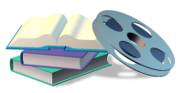
End-to-end Processes in Agile Service Networks
Manage & monitor end-to-end message flow
Client
Client
Client
Client
Client
Interface
Interface
Interfac
Interface
Interface
Interface
Interface
Interface
Interface
Interface
Interface
Workflow / Orchestration Layer
SLA
Composite
Service
Composite
Service
Composite
Service
Composite
Service
Composite
Service
Check SLAs & policies at each point
SLA
SLA
SLA
Service Container
Service Container
Service Container
Service Container
Service
Service
Service
Service
Service
Service
Service
Service
Service
Service
Service
SLA
Service Networks of Global reach
r
Legacy
Applications
CRM
ERP
Databases
Content
Resources
Michael P. Papazoglou © "Research Roadmap in Service Oriented Computing" Summer School, Espoo, Finland - August 26, 2011

Slide 31

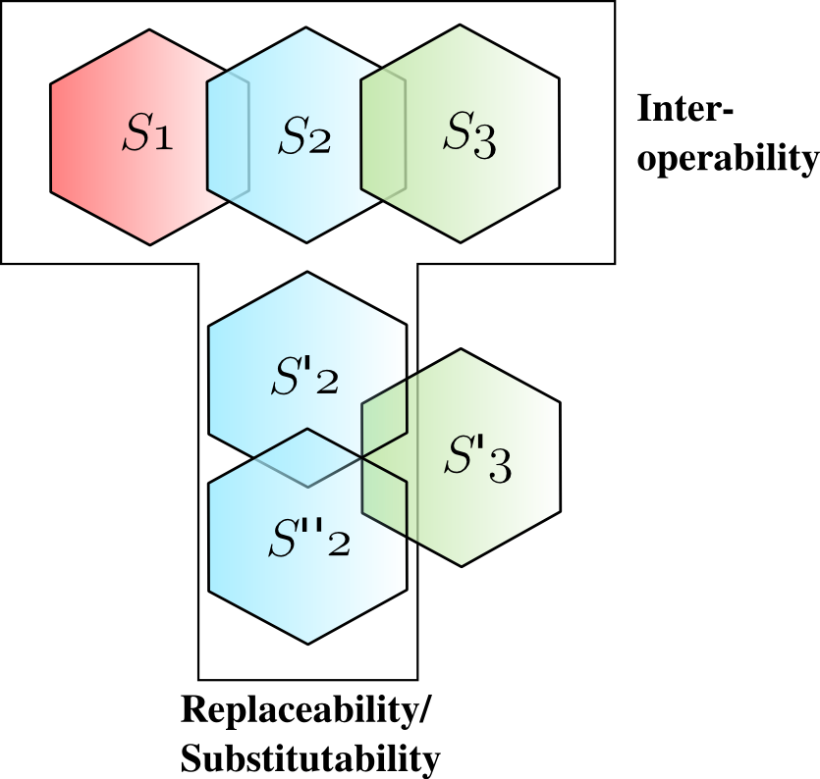
Service Evolution: Shallow vs. Deep Changes
adapter
v₂
v₁
Service
Container
Web
Service
u₁
Client
Web
Service
contract
Service
Container
Provider
Michael P. Papazoglou © "Research Roadmap in Service Oriented Computing" Summer School, Espoo, Finland - August 26, 2011

Slide 32
Business Transactions
Local SLA-Order
Deadline:= 1 day.
Order-condition: Location (Tilburg, NL)
Master SLA-Order
Max-Duration: 7 days
Delivery conditions: XXX
<<Business Transaction >>
Order Management
<<Business Activity>>
Place Order
<<Business Object>>
Sales Order [ACCEPTED]
<<Business Activity >>
vital (atomic) Shipment
Payment [RECEIVED] &
Sales Order [FULFILLED] &
General Ledger [UPDATED]
<<Value Dependency>>
<<Value Dependency>>
<<Business Activity >>
vital (atomic) uest Payment
<<Business Object>>
Bill of Lading [RECEIVED]
Each business activity
changes the state
of the order
for interacting parties.
<<Business Object>>
Invoice [ISSUED]
<<Business Object>>
Sales Order [FULFILLED]
<<Business Object>>
Payment [RECEIVED]
Michael P. Papazoglou © "Research Roadmap in Service Oriented Computing" Summer School, Espoo, Finland - August 26, 2011

Slide 33
SERVICE MGT & MONITORING:
Overview
Core Functionality:
  Decoupling of Services from application
    Redirection of application requests to service invocations
  Hot-Swapping
    Switch between services at runtime
  Advanced Service Selection and Monitoring
  Select services based on business driven requirements
  Service Management
    Security, logging, billing, transaction management, etc
Service management spans installation & configuration to collecting metrics & tuning to ensure responsive service execution
Michael P. Papazoglou © "Research Roadmap in Service Oriented Computing" Summer School, Espoo, Finland - August 26, 2011

Slide 34
SERVICE MGT & MONITORING:
State of the Art
Business Application
(Credit Validation)
Business Application
(Shipping Service)
Management Application
(WSDM)
Enterprise 1
WSDL
Service Interface
Mgmt Interface
Service Interface
Mgmt Interface
Service Interface
Application Channel
WSDM
Management Channel
Enterprise 2
Service Interface
Mgmt Interface
Service Interface
Mgmt Interface
Service Interface
WSDL
Business Application
(Order Processing)
Business Application
(Inventory)
Management Application
(WSDM)
Michael P. Papazoglou © "Research Roadmap in Service Oriented Computing" Summer School, Espoo, Finland - August 26, 2011

Slide 35
SERVICE MGT & MONITORING:
Some Typical Research Challenges
Autonomic management of services:
  Self-configuring mgt services that configure themselves automatically to adapt to different environments & optimize for particular kinds of use.
  Self-adapting mgt services that adapt dynamically to changes in the environment, market and so on, using policies.
  Self-healing mgt services that can discover, diagnose & react to disruptions by taking corrective actions.
  Self-optimizing mgt services that can monitor & tune resources automatically to meet requirements, e.g., reallocating resources in response to dynamically changing workloads, or ensure that business transactions are completed in a timely fashion.
  Self-protecting management services that can anticipate, detect, identify and protect against threats, e.g., unauthorized access and use, & take corrective actions to make themselves less vulnerable.
Michael P. Papazoglou © "Research Roadmap in Service Oriented Computing" Summer School, Espoo, Finland - August 26, 2011

Slide 36
Aspect Oriented Techniques for Service Mgt
Use of AOP concepts & Aspects as interceptors to:
Specify & enforce crosscutting behaviour in a reusable manner
  When the normal execution of a method should be intercepted
  What additional behaviour should be introduced at those points.
Specify deployment details:
  where the crosscutting behaviour should be deployed.
Specify & enforce exceptions/adaptation of services.
Michael P. Papazoglou © "Research Roadmap in Service Oriented Computing" Summer School, Espoo, Finland - August 26, 2011

Slide 37
Closing Remarks

Slide 38
Summary
Research activities in SOC are very fragmented. This necessitates that a broader vision and perspective be established—one that permeates and transforms the fundamental requirements of complex applications that require the use of the SOC paradigm.
We discern three driving forces: SOA, BPM & the Cloud
The SOC research roadmap launches four pivotal, inherently related, research themes to SOC:
  service foundations,
  service composition,
  service management and monitoring, and
  service-oriented engineering.
Michael P. Papazoglou © "Research Roadmap in Service Oriented Computing" Summer School, Espoo, Finland - August 26, 2011

Slide 39
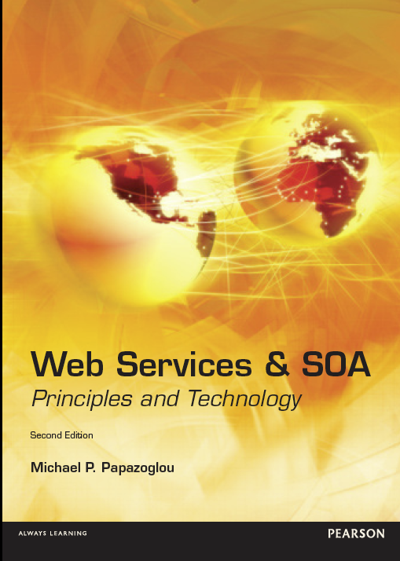
References
BOOKS
M. P. Papazoglou “Web Services: Principles and Technology”,
Prentice Hall, 852 pages, Sept. 2007. (2nd edition January 2012)
M. P. Papazoglou, P.M.A. Ribbers “e-Business: Organizational &
Technical Foundations”, J. Wiley & Sons, 722 pages, March 2006.
W. J. van den Heuvel “Aligning Modern Business Processes and Legacy Systems”, MIT Press, 208 pages, Feb. 2007.
D. Georgakopoulos, M.P. Papazoglou “Readings in Service Oriented Computing”, MIT Press, 658 pages Dec 2008.
RESEARCH PAPERS:
M. P. Papazoglou, W.J. van den Heuvel "Service Oriented Architectures: Approaches,Technologies and Research Issues", VLDB Journal,
vol. 16, July 2007, pp. 389-415.
M. P. Papazoglou, P. Traverso, S. Dustdar, F. Leymann “Service-Oriented Computing: State of the Art and Research Directions”, IEEE Computer, Oct. 2007.
M. P. Papazoglou, W.J. van den Heuvel “Blueprinting the Cloud”, IEEE Internet, Nov. 2011.
Michael P. Papazoglou © "Research Roadmap in Service Oriented Computing" Summer School, Espoo, Finland - August 26, 2011

Slide 40

S-CUBE:
Software Services & Systems Network
Free University Amsterdam
Tilburg University - ERISS
University of
Duisburg-Essen
City University London
University of Hamburg
Lero
University of Stuttgart
INRIA
Vienna University of Technology
Université Claude Bernard Lyon
MTA SZTAKI
Universidad Politécnica de Madrid
University of Crete
Center for Scientific and Technol. Research (FBK)
Politecnico di Milano
Consiglio Nazionale delle Ricerche (CNR)
Michael P. Papazoglou © "Research Roadmap in Service Oriented Computing" Summer School, Espoo, Finland - August 26, 2011

Slide 41


Michael P. Papazoglou © "Research Roadmap in Service Oriented Computing" Summer School, Espoo, Finland - August 26, 2011

