Slide 1
Off the Hook: Real-Time Client-Side Phishing Prevention System
July 28th, 2016
University of Helsinki
Samuel Marchal*, Giovanni Armano*, Kalle Saari*,
Nidhi Singh†, N.Asokan*
*Aalto University - †Intel Security
samuel.marchal@aalto.fi

Slide 2
Outline
Phishing detection system
  minimal training data, language-independence, scalability, resilient to adaptive attack
  highly accurate & fast (comparable to state-of-the-art)
  locally computable
Target identification mechanism
  language-independent, fast
  highly accurate (comparable to state-of-the-art)
Browser Add-on
  client-side computation, redirection to target

Slide 3
Outline
Phishing detection system
  minimal training data, language-independence, scalability, resilient to adaptive attack
  highly accurate & fast (comparable to state-of-the-art)
  locally computable
Target identification mechanism
  language-independent, fast
  highly accurate (comparable to state-of-the-art)
Browser Add-on
  client-side computation, redirection to target

Slide 4
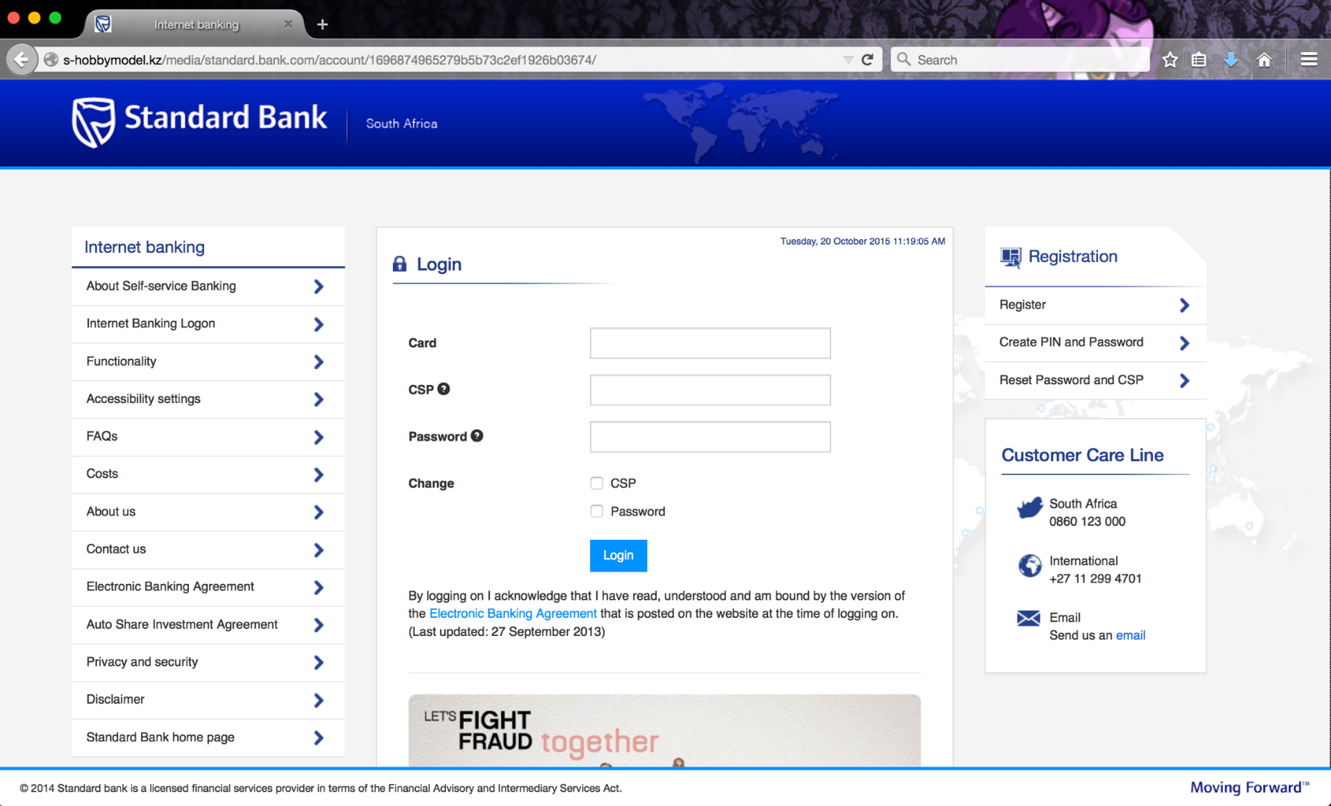
Phishing Website

Slide 5
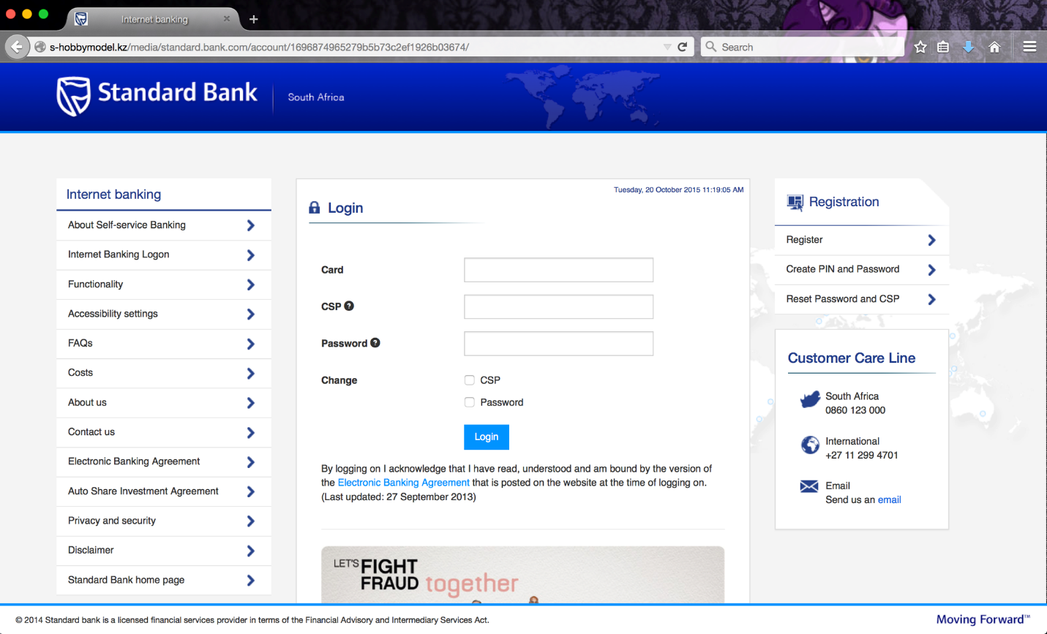
Data Sources
http://my-standard.bankaccount-online.com/login
http://redirect-phish.ru
http://phishing.net/standard-bank/phish
…
Starting URL
Landing URL
Redirection chain
Logged links
HTML source code:
  Text
  Title
  HREF links
  Copyright

Slide 6
Phisher’s Control & Constraints
Phishers have different level of control and are placed under some constraints while building a webpage:
Control: External loaded content (logged links) and external HREF links are not controlled by page owner.
Constraints: Registered domain name part of URL cannot be freely defined: constrained by registration (DNS) policies.

Slide 7
Conjectures
By modeling control/constraints in a feature set we can improve identification of phishing webpages
  Will have good generalizability, be language independent and circumvention will be difficult.
By analyzing terms used in controlled and constrained sources we can identify the target of a phish

Slide 8
URL Structure
FreeURL
RDN
FreeURL
protocol://[subdomains.]mld.ps[/path][?query]
FQDN
https://www.amazon.co.uk/ap/signin?_encoding=UTF8
Protocol = https
FQDN = www.amazon.co.uk
RDN = amazon.co.uk
mld = amazon
FreeURL = {www, /ap/signin?_encoding=UTF8}

Slide 9
Data Sources: Control & Constraints
Control / Constraint separation:
  RDNs are constrained in composition
  FreeURL, text, title, etc. are not constrained
  RDNs in redirection chain controlled (internal) by page owner
  Others RDNs (HREFs and logged links) not controlled (external)
Data sources separation:
 | Unconstrained | Constrained
Controlled | Text Title Copyright Internal FreeURL | Internal RDNs
Uncontrolled | External FreeURL | External RDNs

Slide 10
Phishing Classification System
Feature extraction (212) from data sources:
  URL features (106)
  Term usage consistency (66)
  Usage of starting and landing mld (22)
  RDN usage (13)
  Webpage content (5)
Gradient Boosting classification:
  Feature selection and weighting
  Robustness to over-fitting (generalizability)

Slide 11
Classification Performance
(language independence)
Classifier Training:
  4,531 English legitimate webpages (Intel Security)
  1,036 phishing webpages (PhishTank)
Assessment:
  Legitimate webpages (Intel Security):
    100,000 English
    10,000 each in French, German, Italian, Portuguese and Spanish
  1,216 phishing webpages (PhishTank)

Slide 12
Classification Performance
(language independence)
ROC Curve
Precision vs. Recall
100,000 English legitimate / 1,216 phishs (≈ real world repartition) | Precision | Recall | FP Rate | AUC | Accuracy
 | 0.956 | 0.958 | 0.0005 | 0.999 | 0.999

Slide 13
Outline
Phishing detection system
  minimal training data, language-independence, scalability, resilient to adaptive attack
  highly accurate & fast (comparable to state-of-the-art)
  locally computable
Target identification mechanism
  language-independent, fast
  highly accurate (comparable to state-of-the-art)
Browser Add-on
  client-side computation, redirection to target

Slide 14
Target Identification
Target identification: identify a set of terms representing the impersonated service and brand: keyterms
Assumption: keyterms appear in several data sources
Query search engine with top keyterms to identify:
  If the website is legitimate (appearing in top search results)
  The potential targets of the phishing website
Intersect sets of terms extracted from different visible data sources (title, text, starting/landing URL, Copyright, HREF links)

Slide 15
Target Identification Performance
600 phishing webpages with identified target:
  (unverified phishes listed by PhishTank; identification done manually)
Targets | Identified | Unknown | Missed | Success rate
Top-1 | 526 | 17 | 57 | 90.5%
Top-2 | 558 | 17 | 25 | 95.8%
Top-3 | 567 | 17 | 16 | 97.3%
Complementarity with phishing detection:
  53 mislabeled legitimate webpages (0.0005 FP rate)
  39 identified as legitimate in target identification
Reduction of FP rate to 0.0001 (0.01%)

Slide 16
Outline
Phishing detection system
  minimal training data, language-independence, scalability, resilient to adaptive attack
  highly accurate & fast (comparable to state-of-the-art)
  locally computable
Target identification mechanism
  language-independent, fast
  Highly accurate (comparable to state-of-the-art)
Browser Add-on
  client-side computation, redirection to target

Slide 17
Add-on Implementation
Client-side implementation
  Privacy friendly
  Resilient to adaptive attacks
Multi-browser
  Chrome, Firefox, Safari (in progress)
Cross platform
  Windows (>= 8), Mac OSX (>= 10.8), Ubuntu (>= 12.04)
Phishing warning
  Redirection to target
  Suspicious webpage displayed (user education)

Slide 18
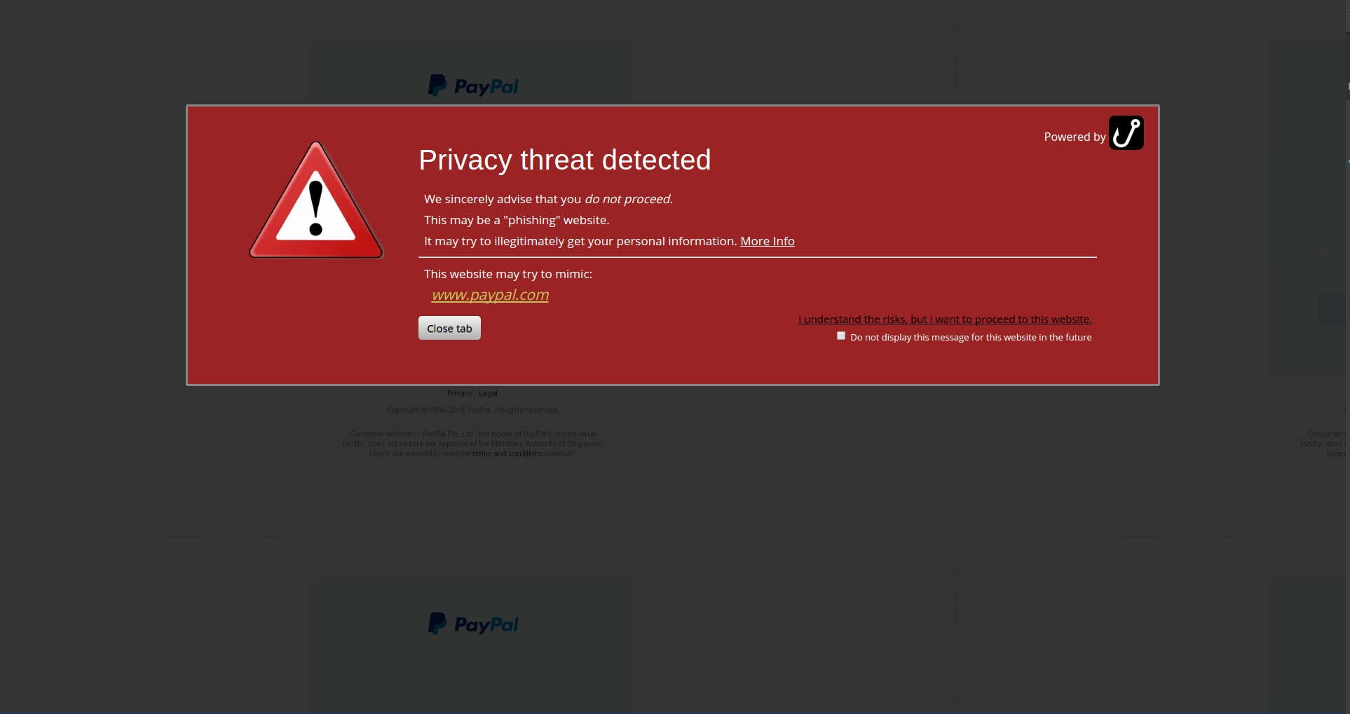
Phishing warning

Slide 19

Performance
Memory usage
  256 MB
Impact on Web surfing
  Phishing webpages:
    Interaction blocked in < 0.5 seconds
    Warning displayed (and target identified) in < 2 seconds
  Legitimate webpages:
    None (albeit false positives)

Slide 20
Summary
Phishing website detection system:
  Language independent / resilient to adaptive attacks
  Fast ( < 0.5 second per webpage)
  > 99.9% accuracy with < 0.05% false positives
Target identification system:
  Fast ( < 2 seconds per webpage)
  Success rate > 90% for 1 target / 97.3% for a set of targets
Phishing detection add-on:
  Guidance towards likely target
  Privacy friendly (client-side-only implementation)

Slide 21

Questions ?
https://ssg.aalto.fi/projects/phishing/

