Slide 1
Deviations of Check-in Locations and Human Mobility Trajectory
Wang Xichen
Electronic Engineering Department
Tsinghua University

Slide 2
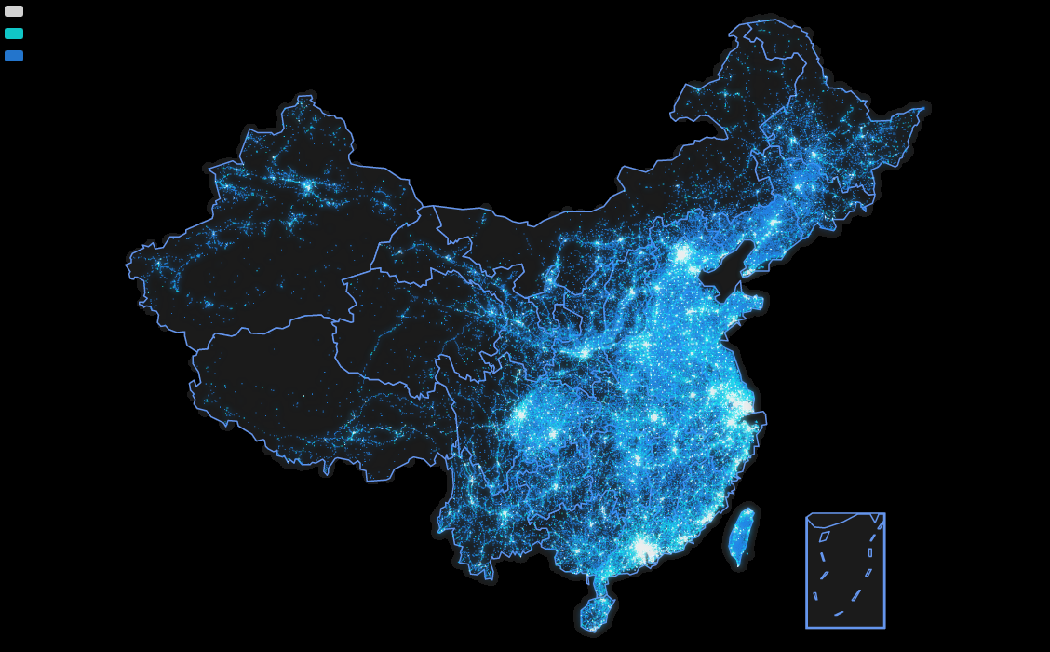
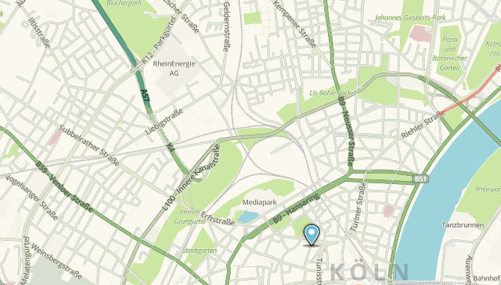
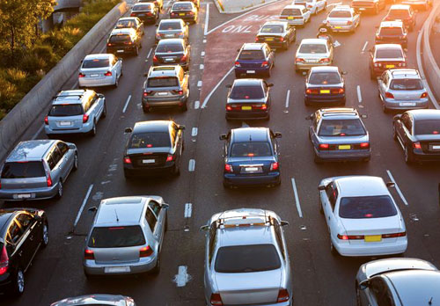



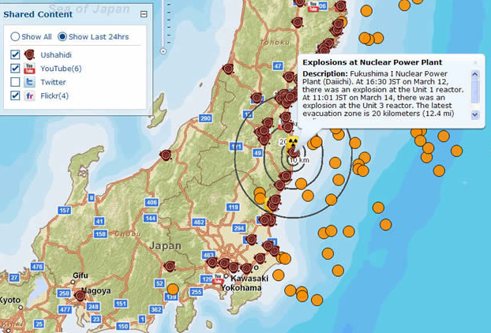
Background
Traffic Planning
Disease Control
Whether the check-ins in this picture is
trustworthy or not？
Infrastructure Deployment
Picking Business Locations
Disaster Response
Notes:
Capturing traces of human movement has the potential to provide deep insights into human behavior, infrastructures like cities and transportation, and computing
applications that support human needs. Therefore, social computing researchers are using data from location based social networks (LBSN), e.g., “Check-in” traces, as approximations of human movement. Accordingly, check-in data of Weibo has become an important data source of location based social network. There even is a picture depicting population density according to check-in data in Weibo. However, we should come into mind that whether the check-ins in this picture is trustworthy or not?

Slide 3
Methodology
DATA: 3G DPI data of 14016 base stations
Tool: 3 clusters of the trafﬁc patterns by KNN
Finding1: Comparison of surfing online & browsing Weibo
Finding2: : Misbehavior of check in behavior
Notes:
in order to better understand the sources of bias and misbehavior in user check-in events, we do research according to Weibo data we acquired from deep packet inspection data, then we cluster the base station into 3 groups of location type to find that the discrepancy when people surfing online and browsing weibo and the misbehaviors of check in behavior.

Slide 4
Methodology
DATA: 3G DPI data of 14016 base stations
Tool: 3 clusters of the trafﬁc patterns by KNN
Finding1: Comparison of surfing online & browsing Weibo
Finding2: : Misbehavior of check in behavior
Notes:
Now, we give a sight to our data.

Slide 5
DATA
The 3G deep packet inspection data for 14016 base stations in Shanghai with the time granularity of 1 second for one week.
Place: Shanghai; Number of base stations: 14016
Time granularity :1 second; Duration: the whole week
Crawled data from Weibo
Notes:
By collaborating with one of the largest Internet Service Provider (ISP) in China, we have obtained an (anonymized) dataset recorded by using a deep packet inspection (DPI) system. This ISP has a 85% of market share for the broadband access in China, and thus the dataset can provide a representative view of Chinese users’ activities. Our utilized dataset was collected between April 21st and April 26th, 2016 with a duration of one week. The data covers 14016 base stations ‘data which includes all base station in shanghai and its time granularity is 1 second. We acquire subsribers’ Weibo ID from the links and then crawled their.

Slide 6
Methodology
DATA: 3G DPI data of 14016 base stations
Tool: 3 clusters of the trafﬁc patterns by KNN
Finding1: Comparison of surfing online & browse Weibo
Finding2: : Misbehavior of check in behavior

Slide 7
Tool
1. The data is processed as vectors of visit times for each BS in each half an hour， thus the input data forms a matrix whose row stands for each station and column stands for the vector.
2、There are three types of traffic patterns for BS in Shanghai with significant different features.
Notes:
Understanding mobile traffic patterns of large scale base stations in urban environment is extremely import for the work. It is the foundation to recognize when and where people want to browse weibo and furthermore, post check-ins. It is also valuable for Internet service providers, mobile users, and government managers of modern metropolis. However, there are several challenges such as unknown traffic patterns, complicated factors of urban ecology and human behaviors that affect traffic patterns. In order to conquer these challenges, we first random select several base stations and the observe its traffic pattern. Then we find that the amount of visit people of each kind of base station at different time can be a notable feature to instruct different kind of base station. So I process the data as the following step:1、divide the whole week into 336 Time interval which is half an hour. Get statistically result of the sum of visit times of each time interval for all base station. In order to reduce the dimension of the data and obtain prominent features, we add the corresponding time interval for weekdays together, and so does data in weekends. So we get an 96 dimension vector whose first 48 element stands for weekdays and the last 48 stands for weekend. Then we can use the discrepancy for traffic change in a day and traffic difference in weekday and work day to distinguish different kind of base station. The second step is to set sample set. because we mainly concerns the places at office, at home and at entertainment places, so we select amout of base station of the above places. We Artificially tags the base stations according to APIs provided by Baidu Map. The result is shown in the slides, The cluster belongs to office often belong to Industrial zone, which features as low access in weekend and high access level in the workday. The line in red is for home, which often have Large scale of residential areas. It features as high visit rate in time to work and time come home,relative high peak in time to eat lunch, while in the weekend, there is no significant peak. The line in black is for entertainment,features as high acces rate in lunch time.

Slide 8
Methodology
DATA: 3G DPI data of 14016 base stations
Tool: 3 clusters of the trafﬁc patterns by KNN
Finding1: Comparison of surfing online & browse Weibo
Finding2: : Misbehavior of check in behavior
Notes:
With the above classification, we can observe the discrepancy of people’s hbbit when surf online and browse weibo.

Slide 9
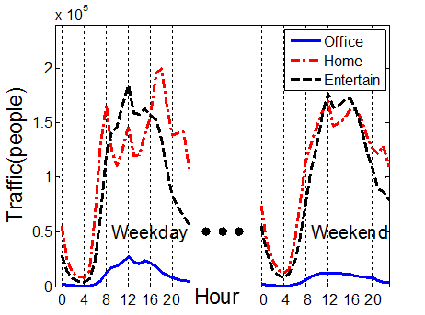
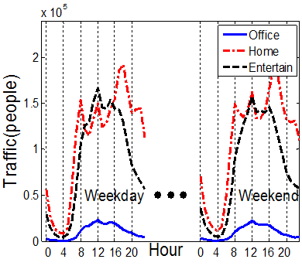
Finding1: Comparison of behavior online and in Weibo
Access behavior online
Access behavior in Weibo
Conclusions:
People have similar access behavior when surfing online and browse Weibo in workdays and have different behavior in the weekend.
People tend to browse Weibo on the road or at lunch, For Home is 8:00,12:00 and 18:00 and for the Entertainment is lunch time.
People at work have much less surfing online behavior.
Notes:
The first picture is when and where people surf the internet, and the second one is when an where the people browse weibo. We can find that People have similar access behavior when surfing online and browse Weibo in workdays and have different behavior in the weekend.
People tend to browse Weibo on the road or at lunch, For Home is 8:00,12:00 and 18:00 and for the Entertainment is lunch time. People at work have much less surfing online behavior.

Slide 10
Methodology
DATA: 3G DPI data of 14016 base stations
Tool: 3 clusters of the trafﬁc patterns by KNN
Finding1: Comparison of surfing online & browse Weibo
Finding2: : Misbehavior of check in behavior
Notes:
Then we find misbehaviors of

Slide 11
Finding 2: Comparison of Positive, Negative and posted check-in
Negative
Positive
Posted
People rarely check-in at work and check in more at entertainment places when positively
People post much more check-ins at work and ignore their existence at home and entertainment places.
Notes:
From the deep packet inspection data, we can find out people utilize location service from some kind of specific URL of weibo. We classify the url into negative and positive. Negtive means that people use the location service without aware of the it. It is Weibo that Actively upload the users’ location. Positive means that people use the location service on specific intend, for example, people want to know what is the point of interest aroud or they want to check-in. We can find that not only in negative location service but also in active location service, only a small amout happens in Office and check in more at entertainment places when positively use location service. However, when we investigate the data we crawed from weibo, we can find that people check-in much more in office and missing check in when they are at home and at entertainment places. This means that people want to leave an impression that he is hardworking.

Slide 12
Finding 3: Comparison of Positive Negative and posted check-in
Conclusions:
Extraneous check-in:Office
Missing check-in:home & Entertain
58% person check-in with irreverent places.
Notes:
For this problem, we select check-ins in line with april 18 to april

Slide 13
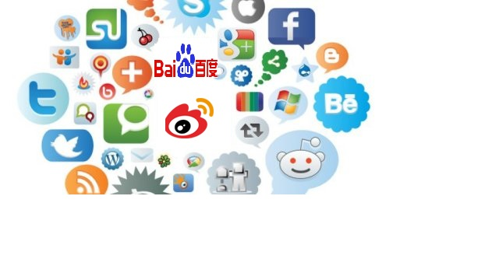
Background
How does Weibo behave as a traffic hub？

Slide 14
Methodology
DATA: 3G DPI data including “Referrer” field
Target 1: Incoming and outgoing transition of Weibo.
Target 2: Outgoing transitions to portal websites
Target 3: Temporal patterns of transitions

Slide 15
Methodology
DATA: 3G DPI data including “Referrer” field
Target 1: Incoming and outgoing transition of Weibo.
Target 2: Outgoing transitions to portal websites
Target 3: Temporal patterns of transitions

Slide 16
Field Name | Explanation
IMSI | The ID of a subscriber
BSID | The ID of a base station which is accessed by the subscriber
Start Time | The start time of the service
Destination URL | The URL of the subscriber’s destination Web site
Referrer | The information of the source link

Slide 17
Methodology
DATA: 3G DPI data including “Referrer” field
Target 1: Incoming and outgoing transition of Weibo.
Target 2: Outgoing transitions to portal websites
Target 3: Temporal patterns of transitions

Slide 18
Target 1: Incoming and outgoing transition of Weibo
Dataset | rank | category
App (In) | 31% | Books
 | 14% | Local
 | 14% | News
 | 13% | Finance
 | 6% | Entertainment
Web (In) | 21% | News
 | 17% | Advertise
 | 13% | Search
 | 11% | Sports
 | 9% | Finance
Dataset | rank | category
App (Out) | 58% | WeiboVideo
 | 9% | Software
 | 6% | Advertise
 | 4% | News
 | 3% | BBS&Blog
Web (Out) | 71% | WeiboVideo
 | 8% | SNS
 | 3% | Advertise
 | 3% | BBS&Blog
 | 2% | News

Slide 19
Methodology
DATA: 3G DPI data including “Referrer” field
Target 1: Incoming and outgoing transition of Weibo.
Target 2: Outgoing transitions to portal websites
Target 3: Temporal patterns of transitions

Slide 20
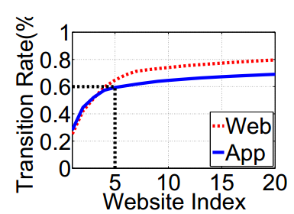
Finding 2: Outgoing transitions to portal websites
Distribution of the overall outgoing transitions
Distribution on Top Chinese Portal websites
60% of Weibo outgoing traffic goes to the top 5 portal webs and among the 5 top websites, Sina ranks 1st.

Slide 21
Methodology
DATA: 3G DPI data including “Referrer” field
Target 1: Incoming and outgoing transition of Weibo.
Target 2: Outgoing transitions to portal websites
Target 3: Temporal patterns of transitions

Slide 22
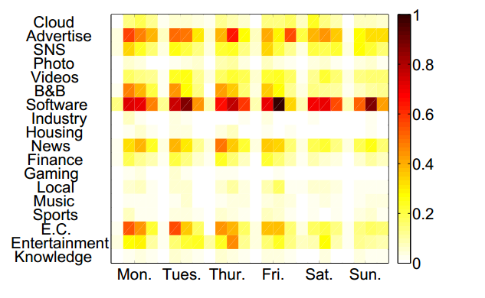
Finding 3:Temporal patterns of transitions
Weibo can lead significant traffic to software if the software has friendly interface with Weibo. Weibo plays an role of traffic hub in this kind of transition.

Slide 23
Summary
There are three type of traffic patterns of base stations, including: office, home and work.
Extraneous check-ins often exit in office and missing check-in tend to happens at home & Entertainment.
58% person check-in with irreverent places.
Outgoing traffic tend to portal websites & softwares

Slide 24
Limitations
Can not handle complicated factors of urban ecology and human behaviors that affect traffic patterns.
Can not classify the district function with location granularity under than a district covered by a base station.

Slide 25
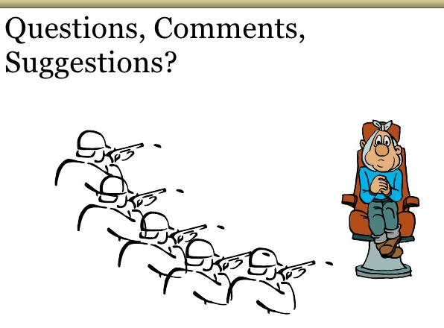
Q&A

