Slide 1
Towards a Unified Framework for String Similarity Joins
Pengfei Xu, Jiaheng Lu
Department of Computer Science, University of Helsinki, Finland

Slide 2
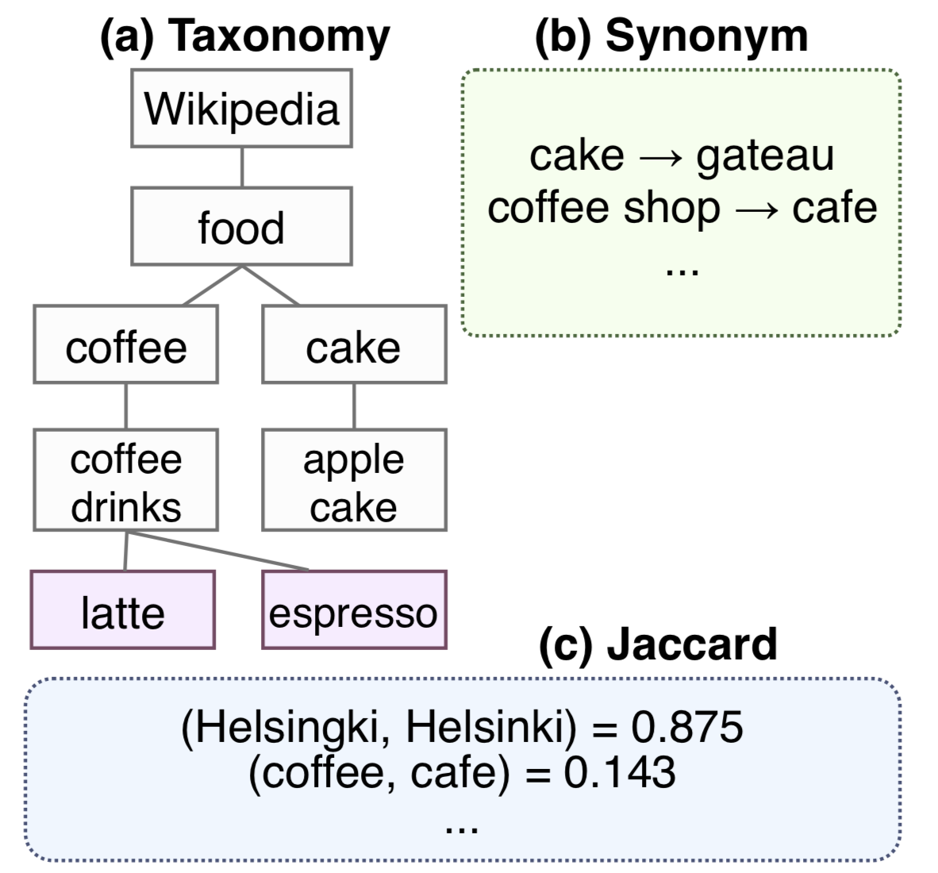
Motivation
When strings are collected from different sources, they may contain some inconsistencies. Established solutions are available:
Related terms
similarity based on taxonomy LCA
Spelling variations
synonym table
Typos / Misspellings
edit distance / q-gram Jaccard
Notes:
Many existing algs are proposed to tackle different similarities, for example, for related terms like latte and espresso, one method is to…
UK and US English, synonym table, define the equivalence

Slide 3
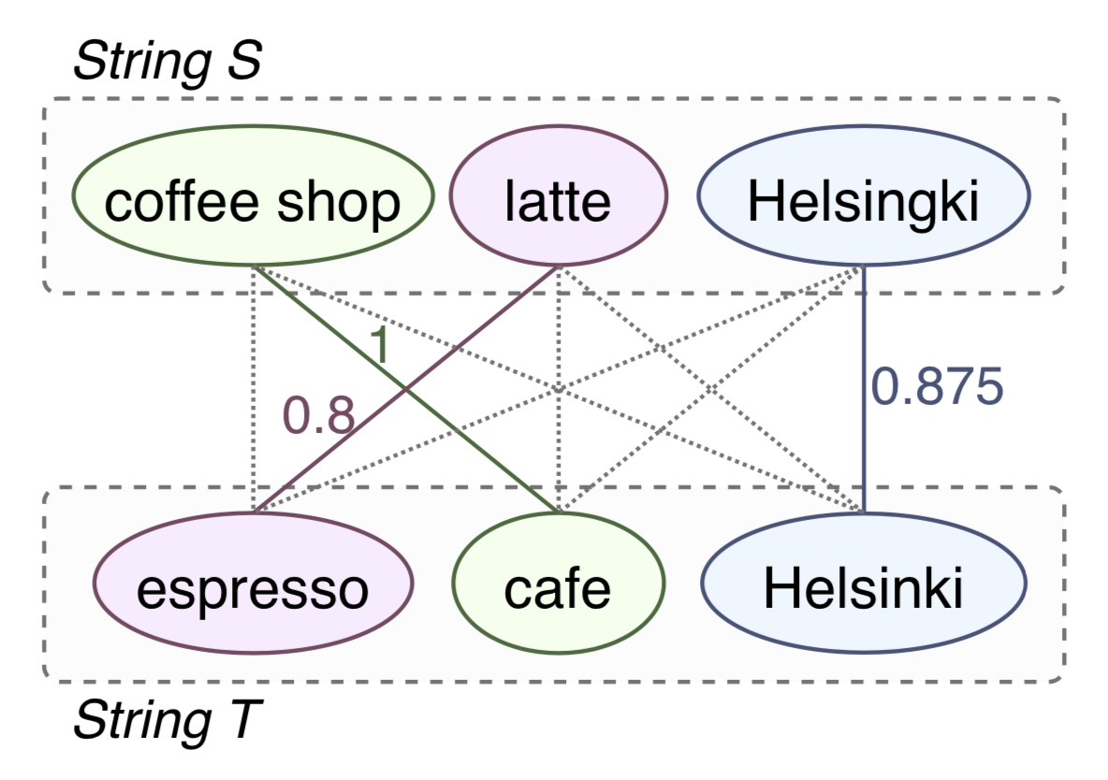
Similarity Measure: The Challenge
However, each of them can only deal with one type of inconsistency which leads to a lower similarity.
Challenge: how to find the similarity of strings w.r.t. multiple inconsistencies?
Notes:
However, in real life two string sets many contain more than one type of ….. As shown in this example.
Therefore, a challenge

Slide 4
The Unified Similarity Measure
Simple case: when strings are segmented, Hungarian algorithm can be used for finding their max similarity.
Example: three kinds of inconsistencies in the figure are captured.
Notes:
In this paper, we answer this challenge by proposing …
Now consider a simple case as in the figure

Slide 5
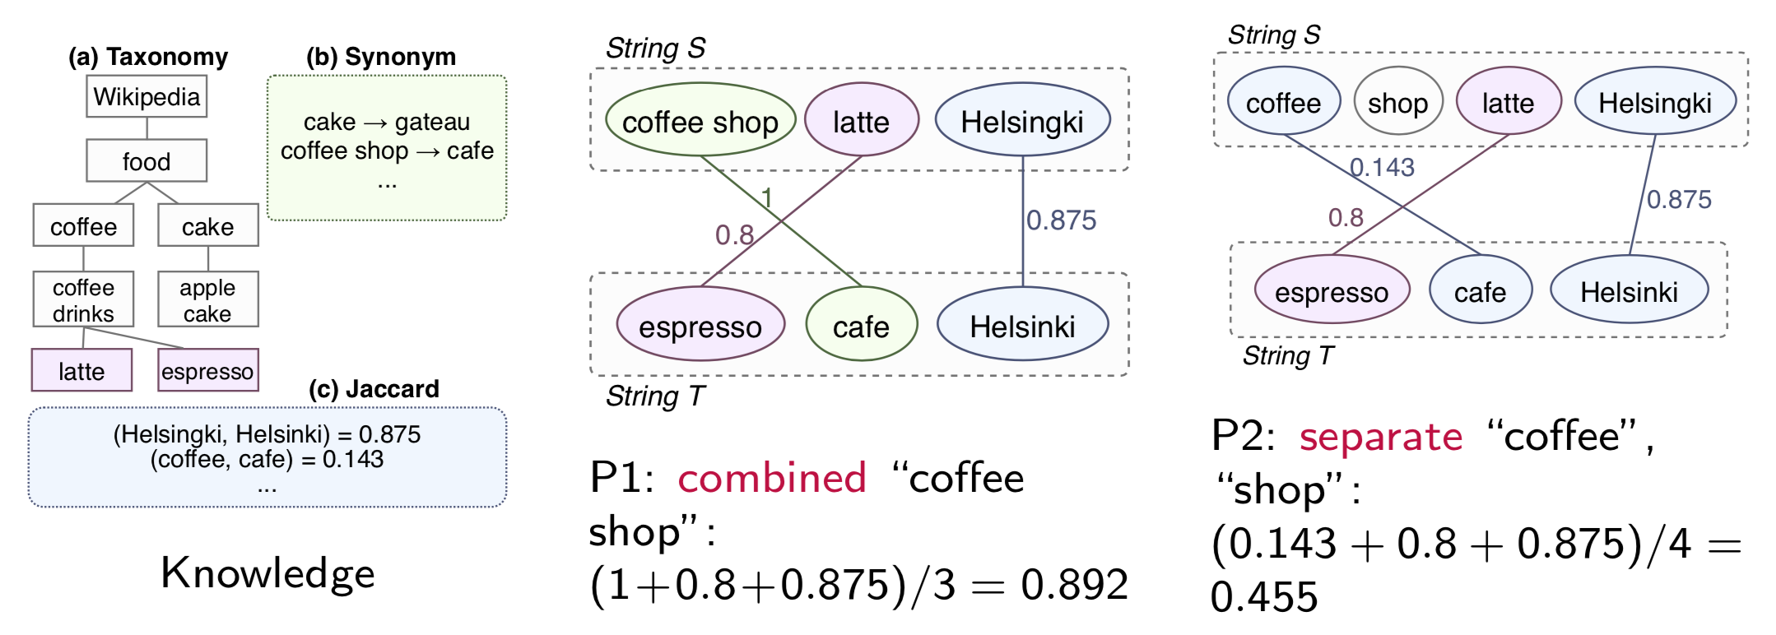
The Unified Similarity Measure (2)
However, raw strings are not segmented. To make things even harder, a pair of strings may have more than one plan of segmentation:
How can we know P1 is the best?
Notes:
Since string are from different sources, in most cases they are not segmented
Now, as we want to find the plan leading to the highest similarity

Slide 6
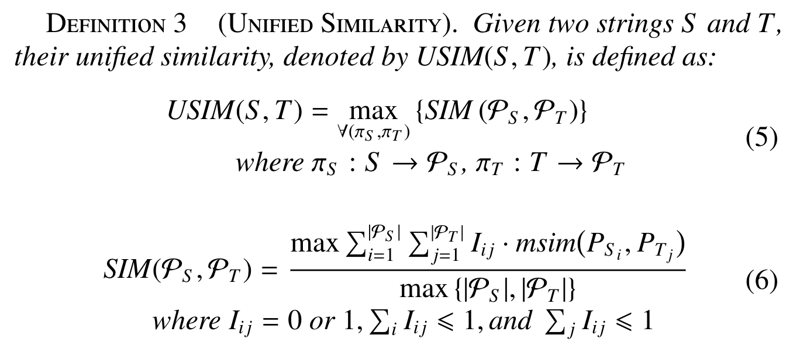
The Unified Similarity Measure (3)
We proved that finding the best segmentation plan is a NP-Hard problem (maximum weighted independent set).

Slide 7
Prerequisite: D-claw Free Graph
A d-claw is a induced subgraph that d independent vertices (“talons”) are connected to a “center” vertex.
A d-claw free graph is a graph that does not pose any d-claw.
5-claw
4-claw
4-claw free graph

Slide 8
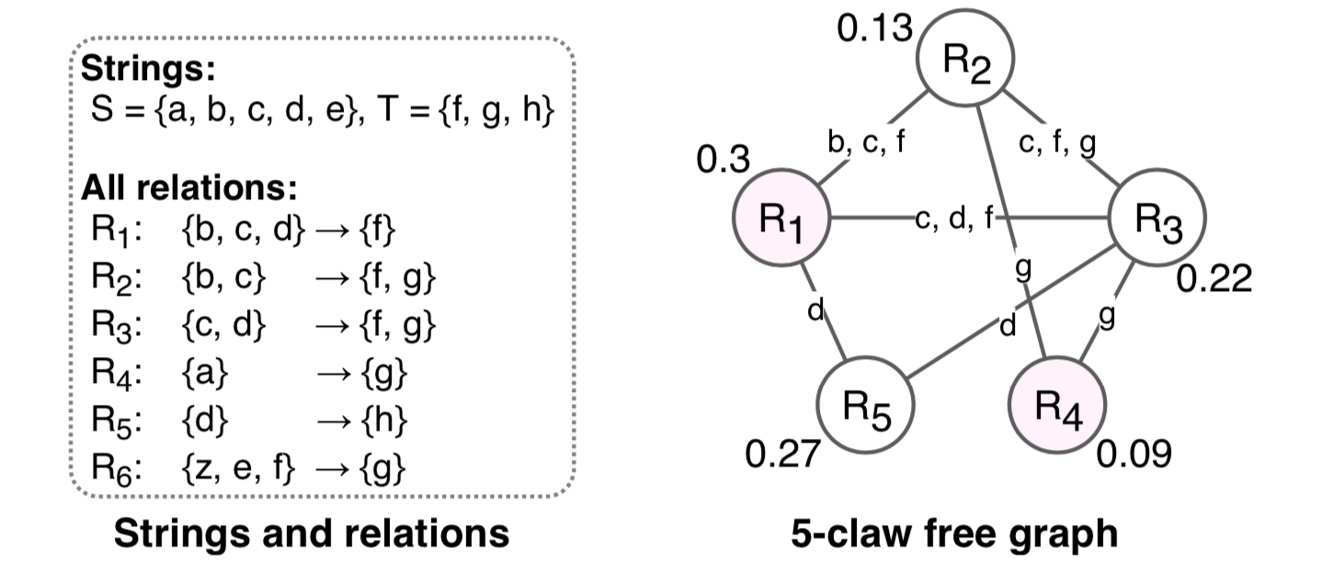
String Segmentation to Claw Free Graph
Each applicable relation (i.e., segment pair) as a vertex, their similarity as weight;
If two relations contain the same word, connect two vertices;
k is the number of words in the longest relation.
Notes:
To apply graph-based algs into our string seg problem

Slide 9
Approximating w-MIS (and Unified Similarity)
The final graph is (k+1)-claw free.
Therefore, we are able to adapt Berman’s SquareImp algorithm which continuously improve the similarity from selected vertices to reach a local optimum.
The result is at most (t/(t-1))(k²-1)/2 times less than the optimum.
Piotr Berman. “A d/2 Approximation for Maximum Weight Independent Set in d-Claw Free Graphs”. In: SWAT. vol. 1851. LNCS. Springer, 2000, pp. 214–219.

Slide 10
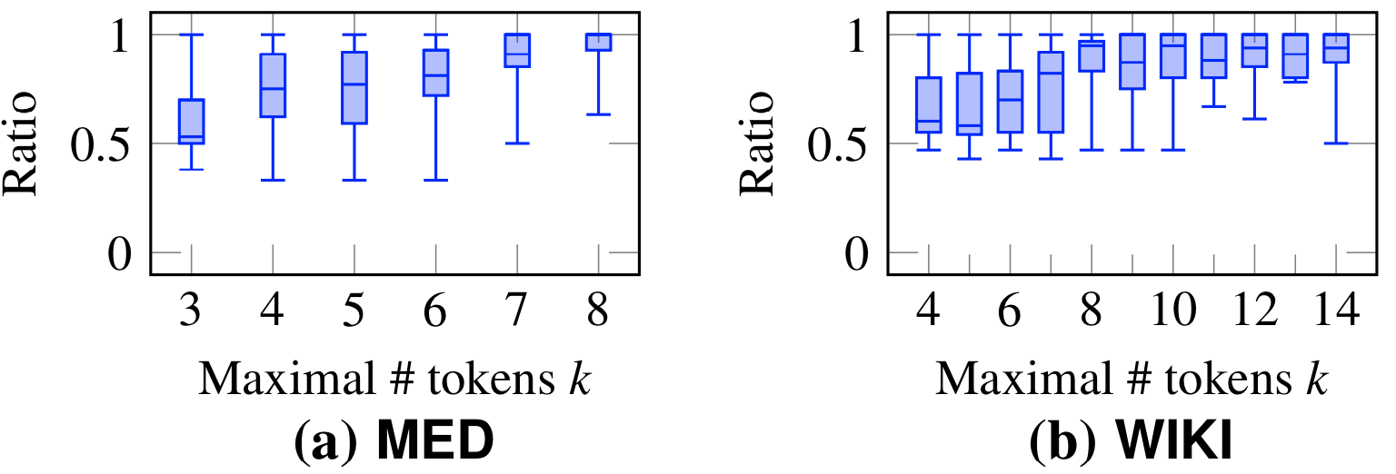
Approximation Algorithm
Our approximation algorithm achieves a non-trivial theoretical bound, and furthermore, it can perform well in real-life experiments:
Notes:
We have also tested the real-life error bound of our alg.
The most majority of tests returns more than 50% of accuracy.

Slide 11
Filtering and Verification
With the unified similarity at hand, we are now ready to deal with join tasks on two string sets.
Here, we use filtering and verification: exclude pairs that are definitely not similar.
S1
T1
S1
T1
S1
✓
T1
S2
T2
S2
T2
S2
T2
Filtering
Verification
S3
T3
S3
T3
S3
✓
T3
✓
S4
T4
S4
T4
S4
T4
S5
T5
S5
T5
S5
✓
✓
T5
All pairs
Candidates
Results
Notes:
We use a popular method called

Slide 12
Prerequisite: Prefix Filtering
By sorting prefix signature of all strings, two similar string must have at least one common signature within their first |N| - |N| * t + 1 signatures.
latte
latte
coffee drinks
coffee
food
Wikipedia
espresso
espresso
coffee drinks
coffee
food
Wikipedia
If they have 0.8 similarity, they must have at least one common signature within first 5 - 5 * 0.8 + 1 = 2 signatures.
They *may* have 0.8 similarity.
Notes:
The most popular method in prefix filtering is prefix...

Slide 13
Prerequisite: Prefix Filtering
By sorting the signature of all strings, two similar string must have at least one common signature within their first |N| - |N| * t + 1 signatures.
latte
latte
coffee drinks
coffee
food
Wikipedia
espresso
espresso
coffee drinks
coffee
food
Wikipedia
If they have 1.0 similarity, they must have at least one common signature within first 5 - 5 * 1.0 + 1 = 1 signature.
They must not have 1.0 similarity!

Slide 14
Unified Prefix Filtering Framework
Generate pebbles for all similarities;
Select signature for prefix filtering;
Extension: allowing more than one overlaps.
Perform filtering by finding pairs having enough overlaps as candidates;
Verify the unified similarity for each candidate.
Taxonomy
Synonym
Jaccard
Pebbles
Prefix Selection
Prefix Signature
Prefix Filtering
Candidates
Calculate sim.
Results
Notes:
Specifically, we extend the original prefix filtering method to allow more-than-one overlaps
…. Because [switch]

Slide 15
Why to allow more-than-one overlaps?
The number of overlaps affects join performance: signature length vs # of FPs.
Notes:
we observed that the number of …. Affects sign length, number of FPs in candidates, and finally the join time

Slide 16
Pebbles: element of signature
Pebble is a generic structure for representing any kind of similarity:
content depend on the type of inconsistency;
assigned with a weight;
weight sum of common pebbles becomes the sim ceiling.

Slide 17
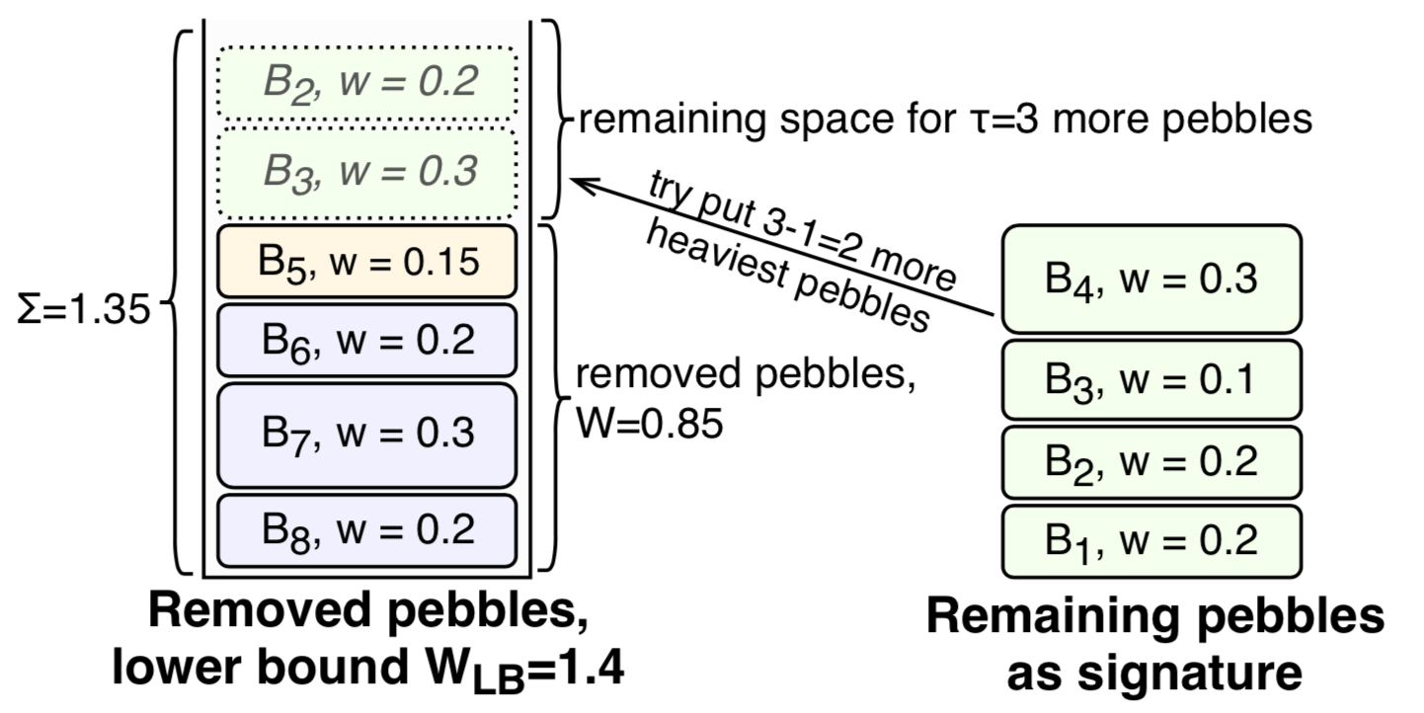
Prefix Selection Methods
Heuristic, runs in a quasi-linear time:
DP, slower but produce shorter signatures:
How to decide the # of overlaps two strings must have?
Notes:
So now the final problem remaining is to decide how many common pebbles we want to find for a specific join task

Slide 18
Join Time Estimation
Pick a series of samples using independent Bernoulli sampling.
Run join algorithm on each sample for many overlap constraints, scale the time to the whole dataset.
Find the constraint that has the least estimated join time.
David Vengerov et al. “Join Size Estimation Subject to Filter Conditions”. In: PVLDB 8.12 (2015), pp. 1530–1541.

Slide 19
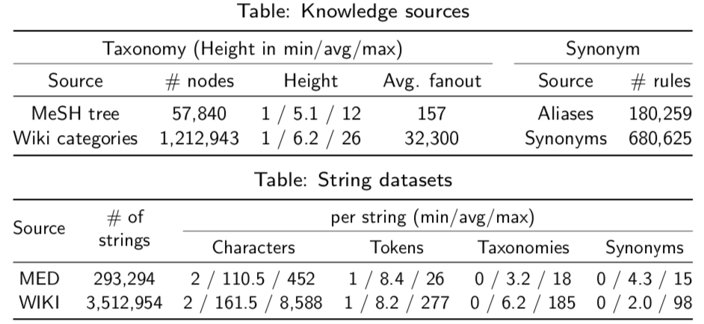
Experimental Results: Datasets
MED: map each research paper to several MeSH keywords.
WIKI: map each Wikipedia article to several category keywords.
Taxonomy and synonym table for each dataset.

Slide 20
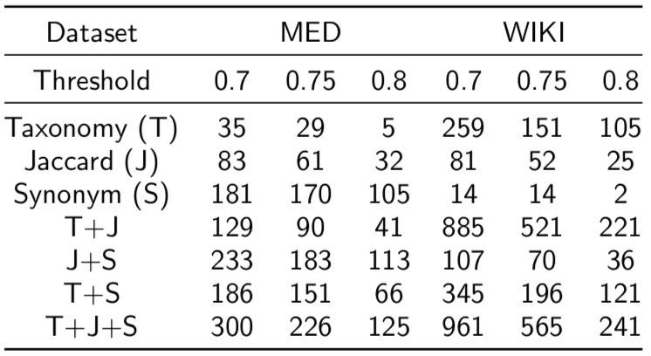
Result Size
Unified methods can find more results than single-similarity methods.

Slide 21
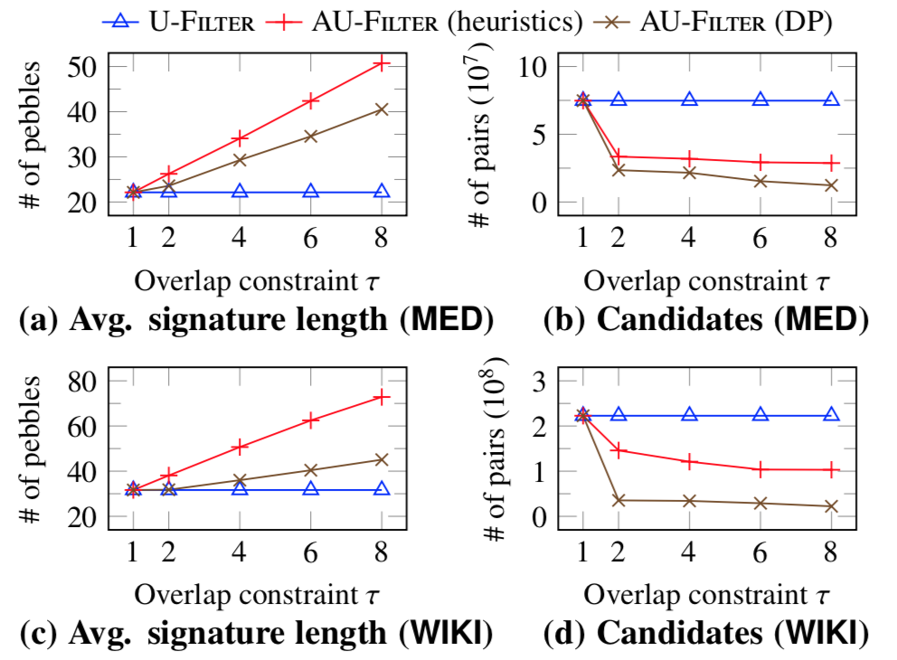
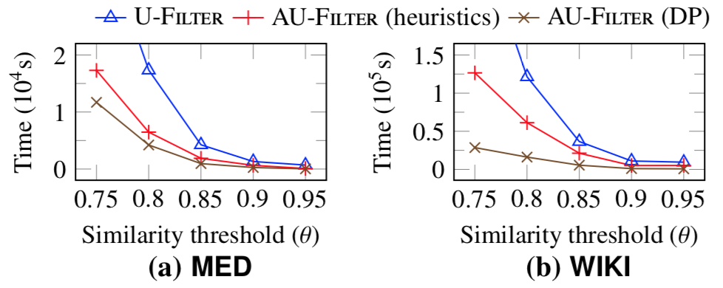
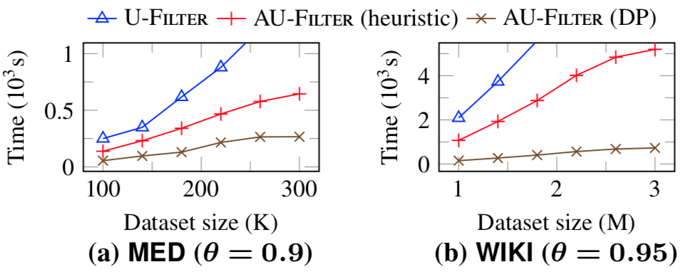
A Few More Results
Overlap constraint affecting the signature length and false positives:
Reduced FPs leads to faster join process (see DP):

Slide 22
Related Works
String similarity matching
Prefix filtering, length filtering, …
AdaptJoin: address the FP problem of one-overlap filtering
Approximation algorithm for w-MIS problem
SquareImp: approximation ratio (k+1)/2
Join size estimation
Independent Bernoulli sampling, end-biased sampling, ...

Slide 23
Conclusion
The quality of join result can be improved significantly by incorporating multiple measures.
Find the maximal string similarity is hard, but can be approximated in polynomial time.
Signature length affects join speed. Sampling-based estimation algorithm works well for finding the best length.

Slide 24
A Kotlin implementation is available at github.com/HY-UDBMS/AU-Join
Have a try!
Thank you very much :)

