Slide 1
Top-k String Auto-Completion with Synonyms
Pengfei Xu and Jiaheng Lu
Department of Computer Science
University of Helsinki

Slide 2
Outline
What is “auto-completion”, and current challenges
Three solutions
  Space-optimised
  Time-optimised
  Meet-in-the-Middle (a NP-Hard problem)
Experiments
Conslusion

Slide 3
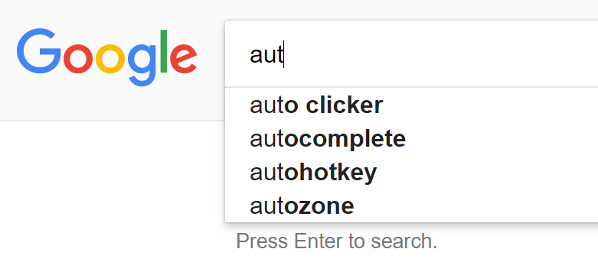
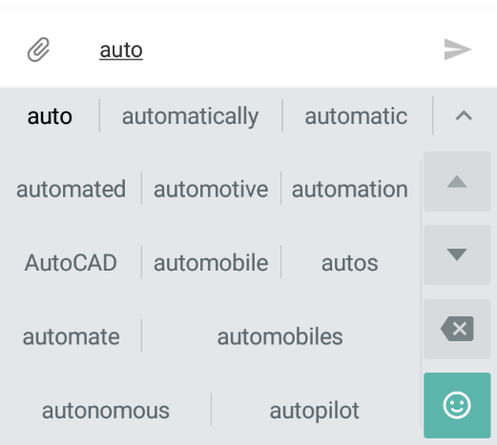

Auto-completion
Search engine
SMS
On-line shopping
Give suggestions based on user input
  Current solutions usually based on the beginning of the input (i.e. prefix).

Slide 4
Limitations
Typos (can be corrected by string similarity measurements, e.g. edit distance[1])
  civilization → civolization
Synonyms
  Andrew → Andy
Abbreviations
  thank you → ty
No efficient solution yet.
(What this paper tries to solve.)
[1] Surajit Chaudhuri and Raghav Kaushik. 2009. Extending autocompletion to tolerate errors. In Proceedings of the 2009 ACM SIGMOD International Conference on Management of data (SIGMOD '09), Carsten Binnig and Benoit Dageville (Eds.). ACM, New York, NY, USA, 707-718. DOI=http://dx.doi.org/10.1145/1559845.1559919

Slide 5
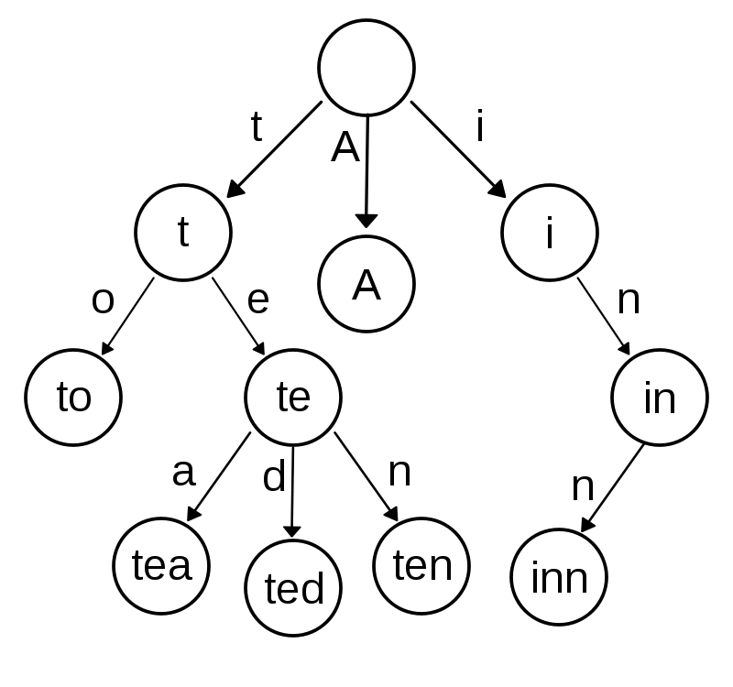
Data structure
A trie (i.e. prefix tree) is a search tree that
  All descendants of a node have a common prefix of the string associated with that node
  Allows fast searching by prefix
We add additional pointers representing synonyms
Source: https://en.wikipedia.org/wiki/File:Trie_example.svg

Slide 6
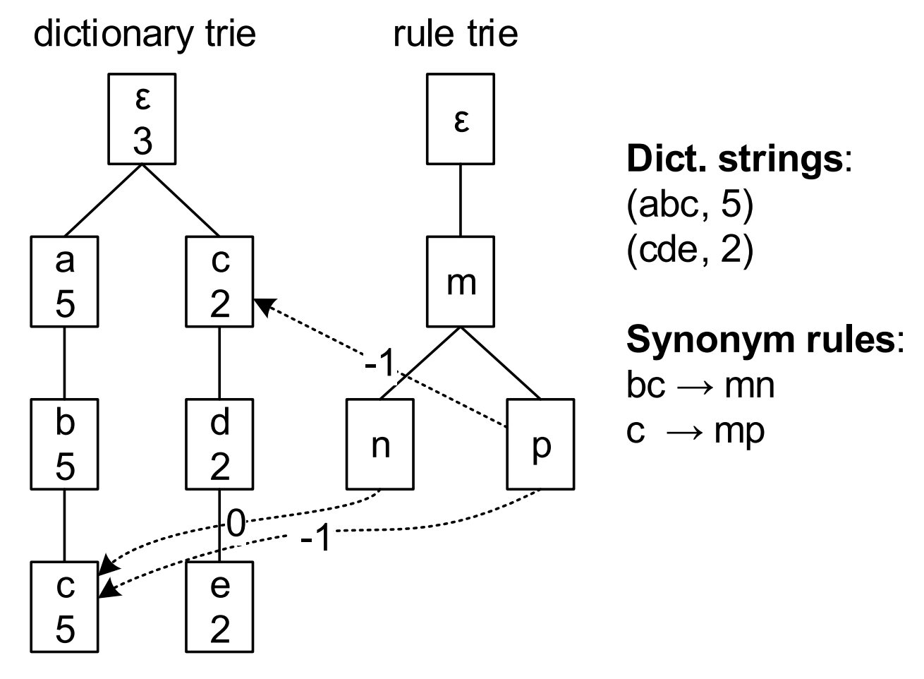
Twin Tries (TT)
Store strings and synonym rules respectively
Links from rule nodes to corresponding dict. Nodes
  Integers on the link indicates the length changes
Top-k: Repeatedly scan the rule trie for any possible matching
Pro: Minimize space occupancy (11 nodes in example)
Con: Extremely slow lookup since the rule trie has been accessed from many times

Slide 7
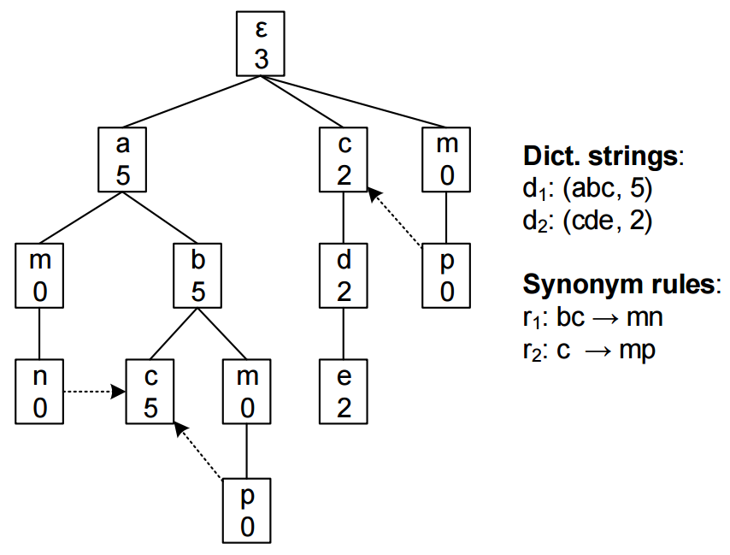
Expansion Trie (ET)
Attach synonym nodes to dict. nodes
Link points to the next character (which is a dict. node)
Top-k: scan from root to leaf
Pro: Fast lookup
Con: Need more space than TT (13 nodes in example)

Slide 8
Trade-off?
+
=
??
TT
Slow lookup
Small size
ET
Fast lookup
Large size
Reasonable lookup speed
Mediocre size

Slide 9
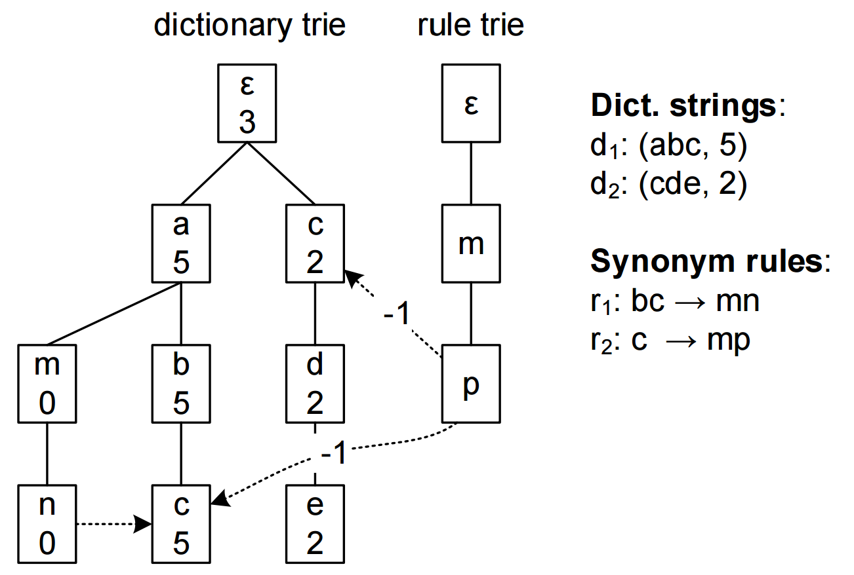
Hybrid Tries (HT)
Expand a part of synonym rules with dictionary strings
Top-k: same as TT (however fewer nodes in the rule trie)

Slide 10
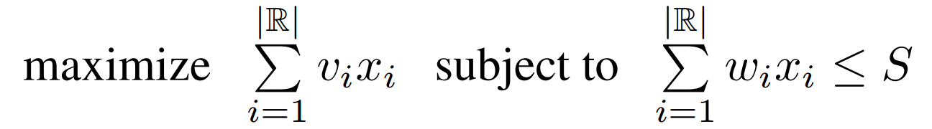

Which rule to expand?
The selection of rules is NP-hard
We model it as a variance of 0/1 knapsack problem
  Given space constraint $S$, frequency (values) $v_{i}$ and space cost $w_{i}$ of each rule $r_{i}$ from $ℝ$, $i∈[1,|ℝ|]$
  Let $\{x_{1},x_{2},…,x_{\left|ℝ\right|}\}$ be a sequence of integers $0$ or $1$.

Slide 11
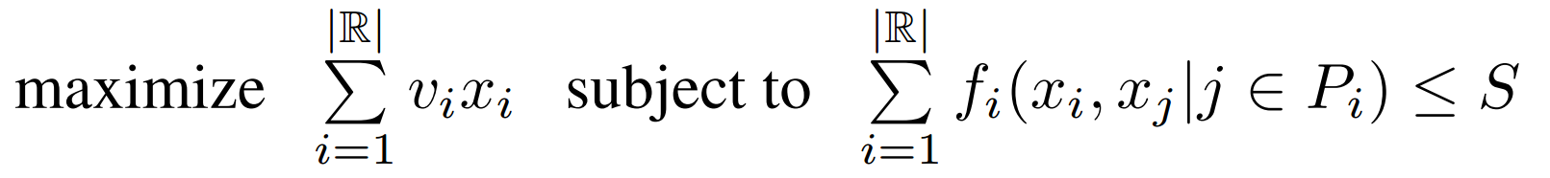
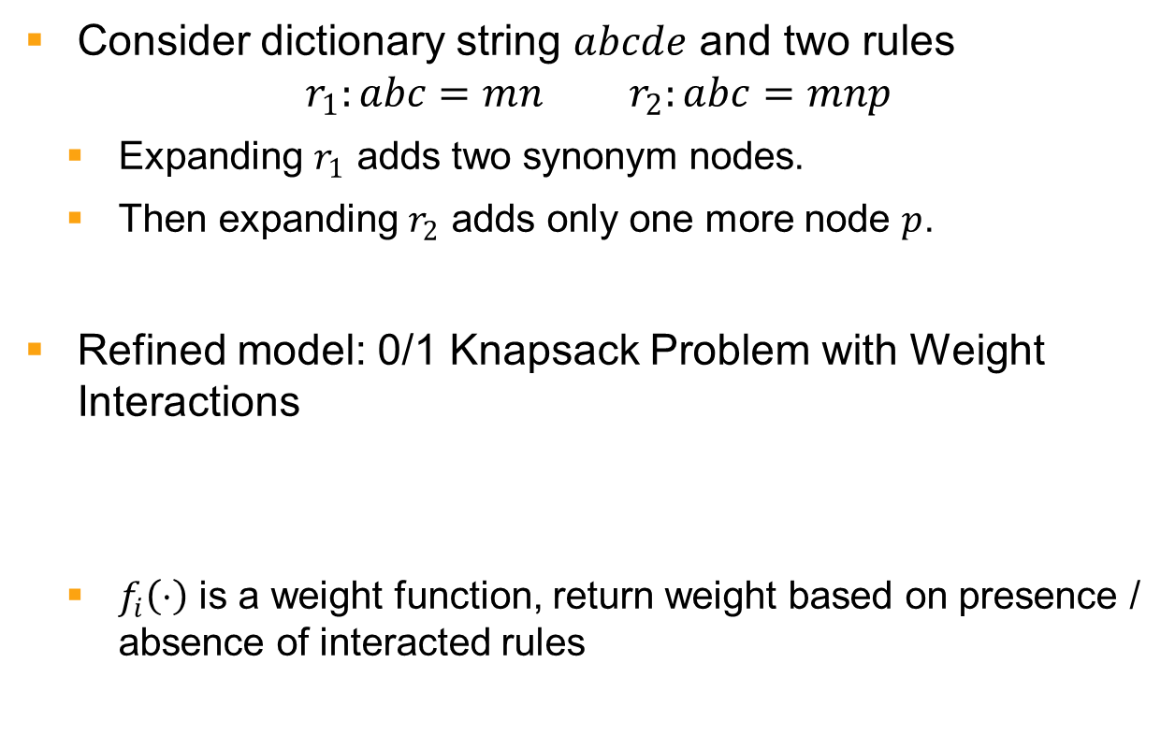
Why “a variance”?
Consider dictionary string $abcde$ and two rules
$r_{1}:abc=mn r_{2}:abc=mnp$
  Expanding $r_{1}$ adds two synonym nodes.
  Then expanding $r_{2}$ adds only one more node $p$.
Refined model: 0/1 Knapsack Problem with Weight Interactions
  $f_{i}\left(⋅\right)$ is a weight function, return weight based on presence / absence of interacted rules

Slide 12
Branch and bound
  Upper bound: sort items by assuming all interactions already existed, then solve a fractional knapsack problem by greedy method.
  Lower bound: greedy take items into knapsack until the weight budget left cannot fit the next item. We assume every interacted item is not included.
Notes:
[B&B] explores branches of [solutions] tree, which represent subsets of the solution set. Before enumerating the candidate solutions of a branch, the branch is checked against upper and lower estimated bounds on the optimal solution, and is discarded if it cannot produce a better solution than the best one found so far by the algorithm.

Slide 13
Branch and bound （2）
Measure exact weight in every branch operation:
  A straightforward solution: scan all rules to accumulate any possible savings (slow when lots of rules)
  Heuristic: pre-partition rules into different parts
    One rule is interacting with all rules in the same part, but none in other parts

Slide 14
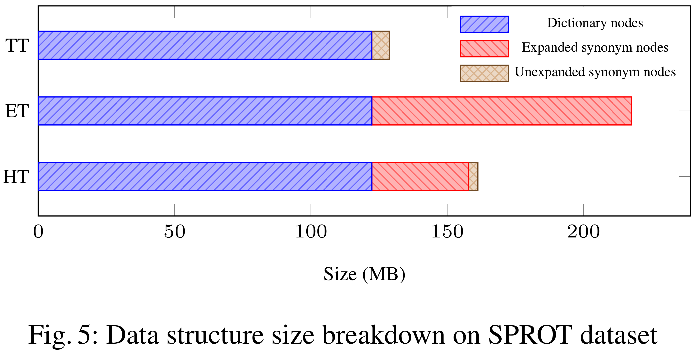
Experiments (size)
Space consumption: TT < HT < ET

Slide 15
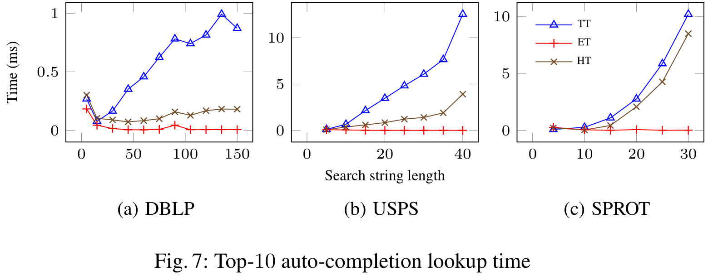
Experiments (lookup time)
Lookup time: ET < HT < TT
Why HT is slow?

Slide 16
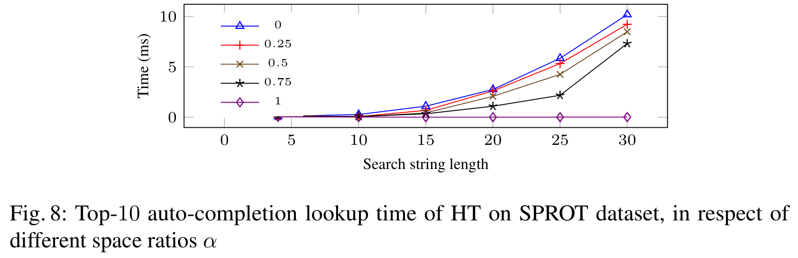

Experiments (lookup time) (2)
$α=$ratio of additional space
If a larger $α$ is selected, HT can be faster (with more space consuptions)

Slide 17
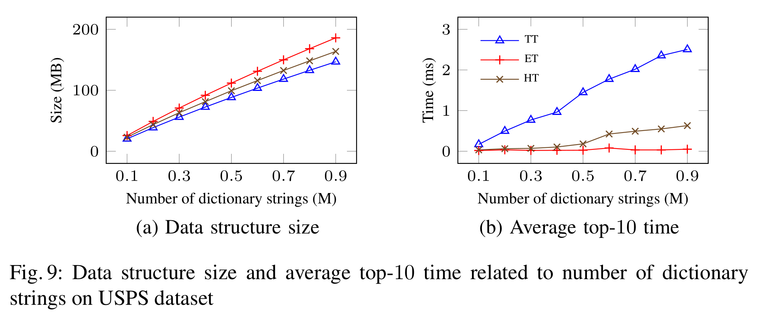
Experiments (scalability)
Size of data structure grows linearly
Top-10 time glows linearly
  ET consumes almost a constant time
  TT consumes more time as data grows, but slowly

Slide 18
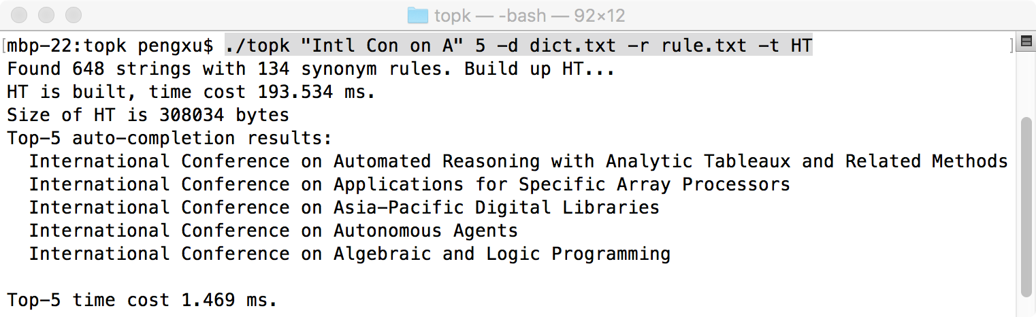
Give a try
The source code and binary executable of our implementation is available at http://udbms.cs.helsinki.fi/?projects/autocompletion
DBLP sample dataset [1] attached
[1] The DBLP dataset is licensed under the Open Data Commons Attribution License (ODC-BY 1.0). Details available at http://dblp.uni-trier.de/db/copyright.html.

Slide 19
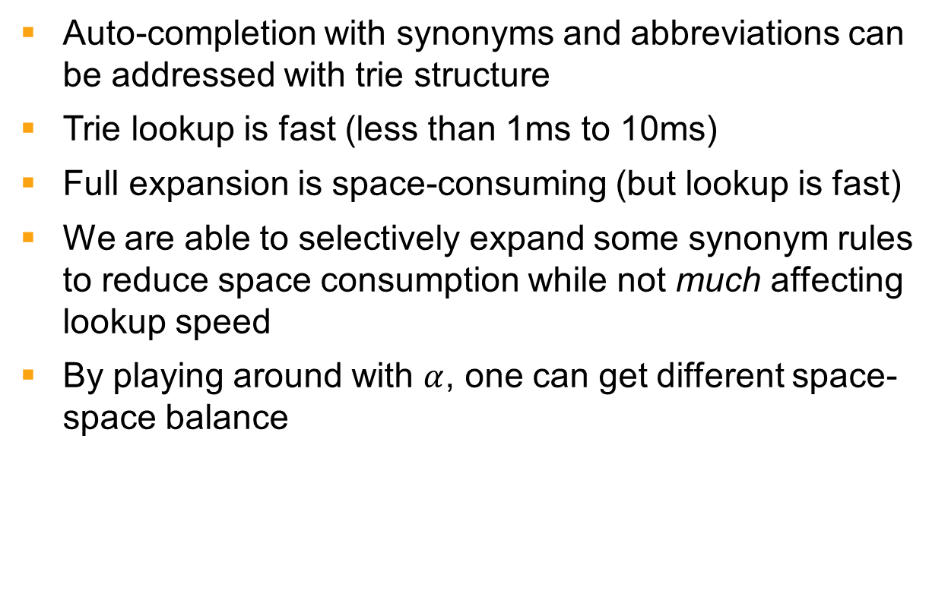
Conclusion
Auto-completion with synonyms and abbreviations can be addressed with trie structure
Trie lookup is fast (less than 1ms to 10ms)
Full expansion is space-consuming (but lookup is fast)
We are able to selectively expand some synonym rules to reduce space consumption while not much affecting lookup speed
By playing around with $α$, one can get different space-space balance

Slide 20
Pengfei Xu, Jiaheng Lu:
Top-k String Auto-Completion with Synonyms. DASFAA (2) 2017: 202-218

