Slide 1
Introduction to Column-Oriented Databases
Seminar: Columnar Databases, Nov 2012, Univ. Helsinki

Slide 2
Content
Introduction
Row-Oriented Execution
Column-Oriented Execution
Experiments
Conclusion

Slide 3
Introduction
Column-oriented database: Each column is stored contiguously on a separate location on a disk.
Column-stores ideas begins in late 70’s.
MonetDB[1] and C-store[2] has been intoduced in 2000’s.
Star Schema Benchmark (SSBM)[3] has been implemented with column-stores as possible.

Slide 4
Row-Oriented Execution
The implementation of column-stores in a row-stored based system.
Three techniques are being introduced:
Vertical Partitioning
Index-Only Plans
Materizalized Views

Slide 5
Vertical Partitioning
Process:
Full vertical partitioning of each relation
Each column = 1 physical table
This can be achieved by adding integer position column to every table
Join on Position for multi column fetch
Problems:
‘Position’ - Space and disk bandwidth
Header for every tuple – further space waste

Slide 6
Index-Only Plans
Process:
Add B+Tree index for every table.column
Build list of (record-id, value) pairs satisfying predicates on each table
Merge the lists in memory when there are multiple predicates on the same table
Problem:
Separate indices may require full index scan, which is slower
Eg: SELECT AVG(salary) FROM emp WHERE age > 40
Composite index with (age, salary) key helps

Slide 7
Materialized views
Process:
Create ‘optimal’ set of MVs for given query workload
Objective:
Provide just the required data
Avoid overheads
Performs better
Expected to perform better than other two approaches
Problem:
Practical only in limited situation
Require knowledge of query workloads in advance

Slide 8
Column-Oriented Execution
Optimization approaches to improve the performance of column-stores.
Four techniques are being introduced:
Compression
Late Materizalization
Block Iteration
Invisible Join[4] (a new technique)

Slide 9
Compression
Low information entropy (high data value locality) leads to high compression ratio.
Advantages
Disk space is saved.
Less I/O from disk to memory (or from memory to CPU)
Performance can be further improved if we can perform operation directly on compressed data.
Light weight compression schemes do better.

Slide 10
Late Materialization
Most query results entity-at-a-time not column-at-a-time
At some point of time multiple column must be combined
Performance can be improved by using late-materialization
Keep the data in columns until much later in the query plan, operating directly on these columns.
Eg: SELECT R.a FROM R WHERE R.c = 1 AND R.b = 7
Output of each predicate is a bit string
Perform Bitwise AND
Use final position list to extract R.a
Advantages: Unnecessary construction of tuple is avoided, direct operation on compressed data

Slide 11
Block Iteration
Operators operate on blocks of tuples at once.
Iterate over blocks rather than tuples
Like batch processing
Block of values from the same columns are sent to an operator in a single function call.
If column is fixed width, it can be operated as an array.
Minimizes per-tuple overhead
Exploits potential for parallelism

Slide 12
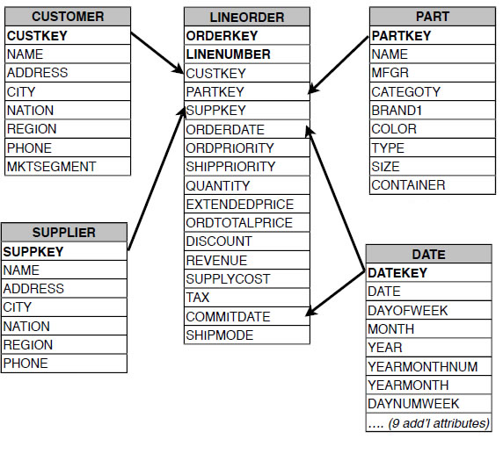
Invisible Join - SSBM tables

Slide 13
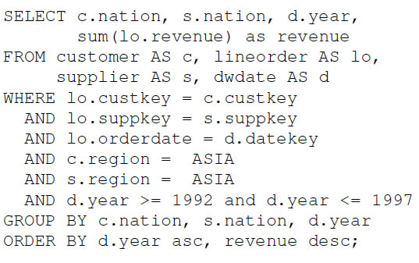
Invisible Join - A query
Find total revenue from Asian customers who purchase a product supplied by an Asian supplier between 1992 and 1997 grouped by nation of the customer, supplier and year of transaction

Slide 14
Invisible Join – Cont’d
Traditional plan for this type of query is to pipeline join in order of predicate selectivity
Alternate plan is late materialized join technique
But both have disadvantages
Traditional plan lacks all the advantages described previously of late materialization
In the late materialized join technique group by columns need to be extracted in out-of-position order

Slide 15
Invisible Join – Cont’d
Invisible join is a late materialized join but minimize the values that need to be extracted out of order
Invisible join
Rewrite joins into predicates on the foreign key columns in the fact table.
These predicates can be evaluated by hash-lookup.

Slide 16
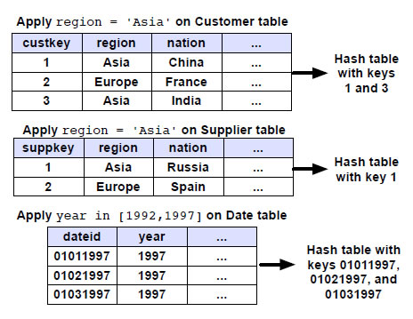
Invisible Join - The first phase of Invisible Join

Slide 17
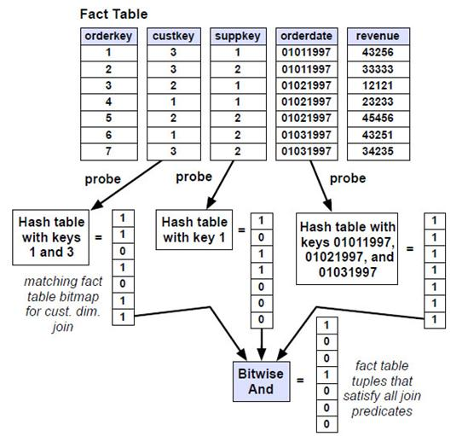
Invisible Join - The second phase of Invisible Join

Slide 18
Invisible Join - The third phase of Invisible Join

Slide 19
Experiments [4]
Column-store simulation in a row-store to find out whether it is possible for a row-store to obtain the benefits of column-oriented design.
Column-store performance after removing the optimizations to find out which optimizations are most significant.

Slide 20
Experiments - Environment
2.8 GHz Dual Core Pentium(R) workstation
3 GB RAM
RHEL 5
4 disk array mapped as a single logical volume
Reported numbers are average of several runs
Warm buffer (30% improvement for both systems)
Star Schema Benchmark (SSBM) with the fact table (17 columns, 60,000,000 rows) and 4 dimension tables (largest one: 80,000 rows)

Slide 21
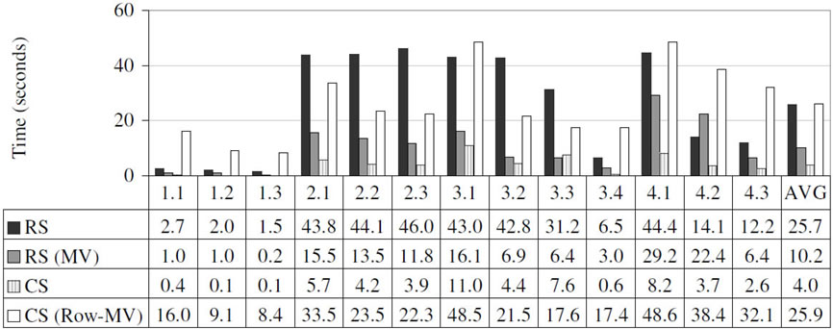
Baseline performance of C-store and System X
RS = System X (row-store) CS = C-store (column-store) RS (MV) = System X materialized view CS (Row-MV) = Row-MV in C-Store

Slide 22
Baseline performance Results
From the graph we can see
C-Store performs better than System X by a
Factor of six in the base case
Factor of three when System X use materialized view
However CS (Row-MV) (row-oriented materialized view inside C-Store) performs worse than RS (MV)
System X provide advance performance feature
C-Store has multiple known performance bottlenecks
C-Store doesn't support partitioning, multithreading

Slide 23
Column-store simulation in a row-store
Five different configurations:
Traditional row-oriented representation with bitmap
Traditional (bitmap): Biased to use bitmaps; might be inferior sometimes
Vertical Partitioning: Each column is a relation
Index-Only: B+Tree on each columns
Materialized Views: Optimal set of views for every query

Slide 24
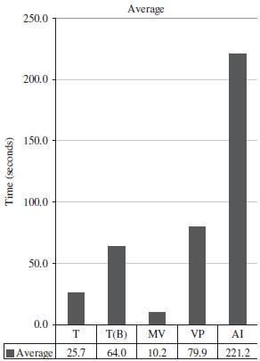
Average performance across all the queries
T = Traditional T(B) = Traditional Bitmap MV = Materialized View VP = Vertical Partitioning AI = All indexes

Slide 25
Column-store simulation in a row-store - Results
MV performs best since they read minimal amount of data needed by a query.
Index only plans are the worst:
Expensive column joins on fact table
Unable to use merge join
Vertical partitioning:
Tuple overheads and reconstruction
LineOrder Table – 60 million tuples, 17 columns
Compressed data

Slide 26
Column-store performance
Column-store performs better than the best case of row-store (4.0sec - 10.2sec)
Approach:
Start with column-store (C-Store)
Remove column-store-specific performance optimizations which are compression, block processing, late materialization, invisible join.
End up with column-store having a row-oriented query executer

Slide 27
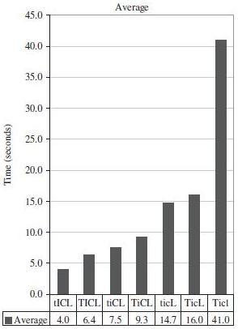
Column-store performance - Average performance numbers for C-Store across all queries while various optimizations removed
T= tuple-at-a-time processing t= block processing I=invisible join enabled i= disabled C= compression enabled c= disabled L= late materialization enabled l= disabled

Slide 28
Column-store performance - Results
Block processing improves the performance by a factor of 5% to 50% depending on the compression.
Compression improves the performance by almost a factor of 2.
Late materialization improves performance by almost a factor of 3 because of the selective predicates.
Invisible join improves the performance by 50-75%.
The most significant optimizations are compression and late materialization.
After all the optimizations are removed, the column store acts just like a row store.
Column-stores are faster than simulated-column stores.

Slide 29
Conclusion
To emulate column-stores in row-stores, techniques like
Vertical portioning
Index only plan
does not yield good performance for the reasons of
Tuple reconstruction costs
Per tuple overheads.
Reasons why column-stores have good performance
Late materialization
Compression
Block iteration
Invisible join

Slide 30
Open Question
Building a complete row-store that can transform into a column-store on workloads where column-stores perform well.

Slide 31
References
[1] S. Idreos, F. Groffen, N. Nes, S. Manegold, S. Mullender, M. Kersten. MonetDB: Two Decades of Research in Column-oriented Database Artitectures. 2012.
[2] M. Stonebraker, D. J. Abadi, A. Batkin, X. Chen, M. Cherniack, M. Ferreira, E. Lau, A. Lin, S. R. Madden, E. J. O’Neil, P. E. O’Neil, A. Rasin, N. Tran, S. B. Zdonik. C-Store: A Column-Oriented DBMS. In VLDB, pages 553–564, 2005
[3] E. O’Neil, X. Chen, E. J. O’Neil. Adjoined Dimension Column Index (ADC Index) to Improve Star Schema Query Performance. In ICDE, 2008 and http://www.cs.umb.edu/poneil/StarSchemaB.PDF.
[4] D.J. Abadi, S.R. Madden, N. Hachem. Column-stores vs. row-stores: how different are they really? In Proc. SIGMOD, 2008

Slide 32
Thanks for your attention, Any comments, questions?
Seminar: Columnar Databases, Nov 2012, Univ. Helsinki

